Slide 1
PERINEUM
DR OSO (MBBS, M.Sc, FMCS, FWACS)

Slide 2
OUTLINE
INTRODUCTION
  Bony pelvis
  Lesser pelvis
  Pelvic floor
PERINEUM
  Boundaries
  Divisions
  Fascia
  Contents
PERINEAL SPACE
  Superficial perineal space
  Deep perineal space
  Pelvic fascia

Slide 3
INTRODUCTION
Perineum is a diamond-shaped region positioned inferiorly to the pelvic floor between the thighs.
Its crucial for urinary, defaecatory and sexual function. It also supports pelvic organs during childbirth
The pelvic cavity is separated from the perineum by the pelvic diaphragm, formed by the levator ani and coccygeus muscles
The pelvic floor is a group of muscles, ligaments, and tissues forming a supportive sling at the base of the pelvis, holding up organs like the bladder, uterus (in females) and bowels

Slide 4
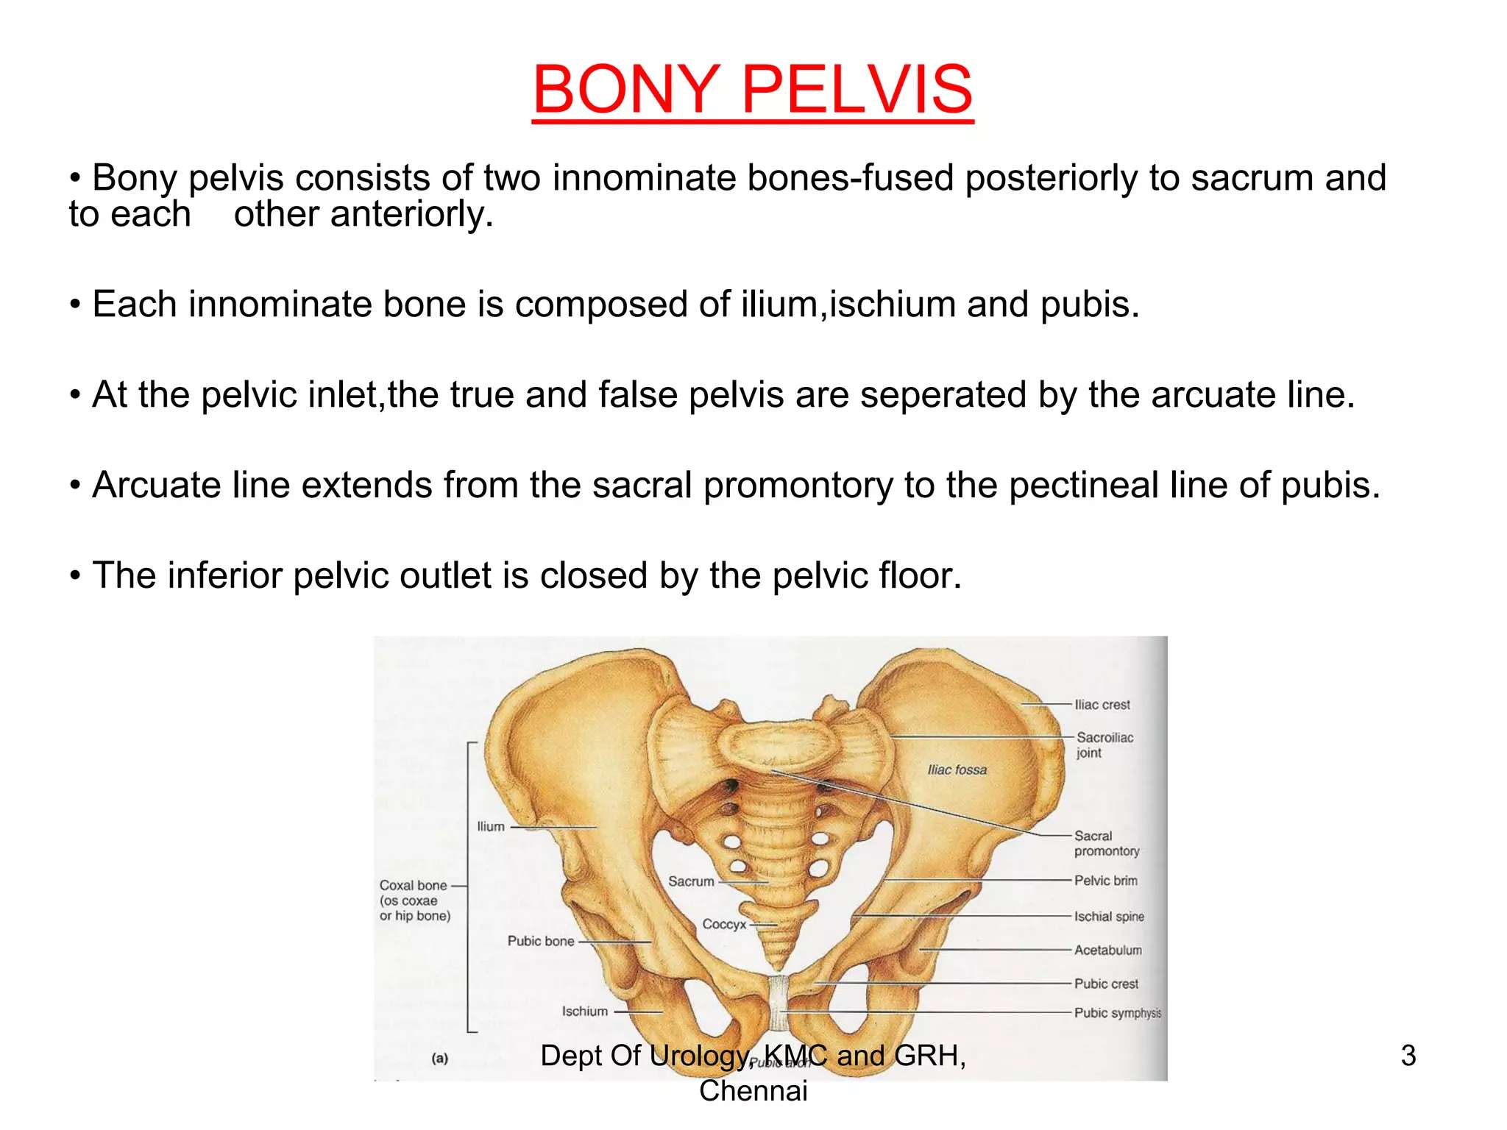

Slide 5
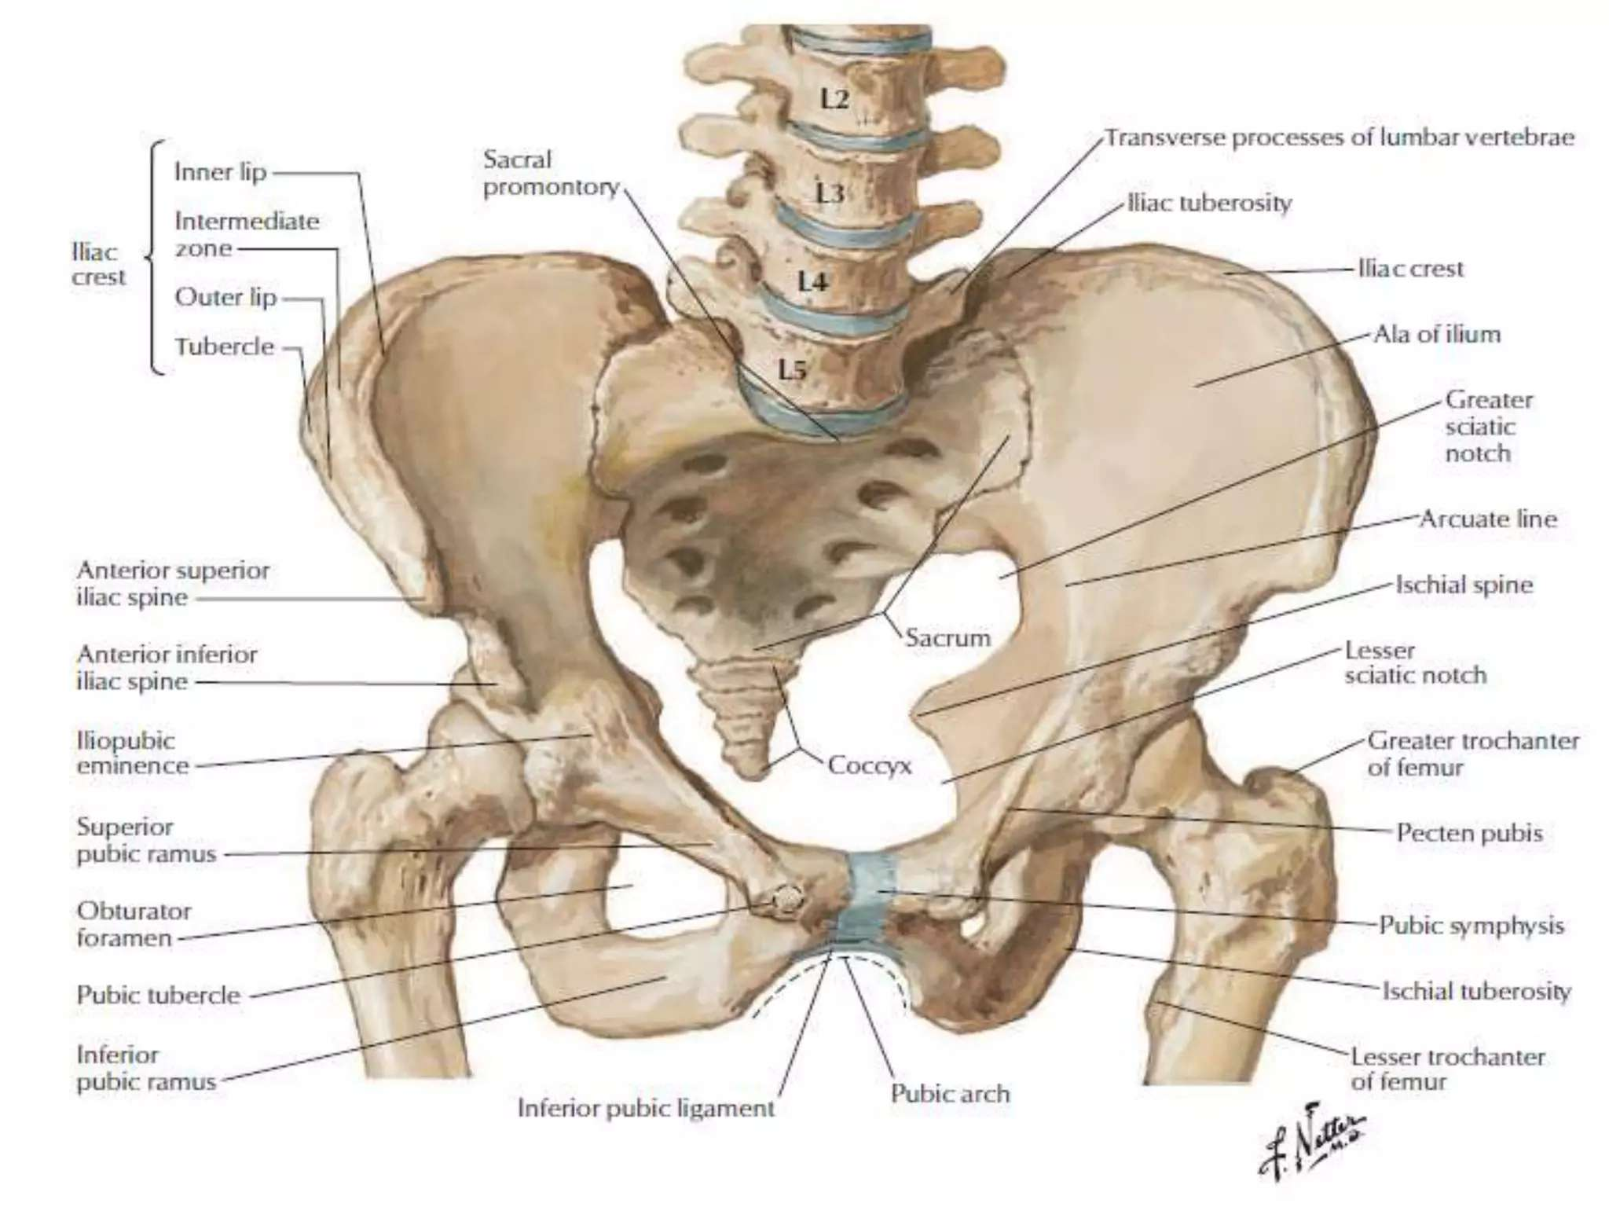

Slide 6
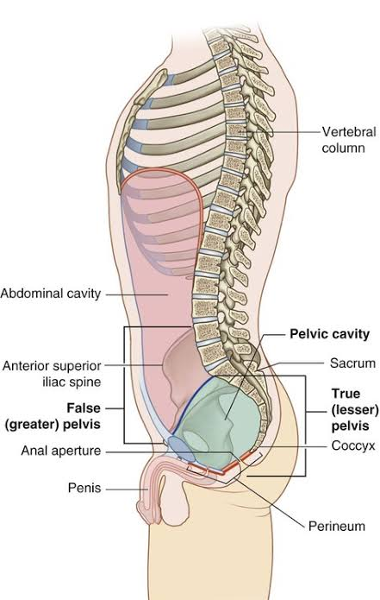
Lesser pelvis

Slide 7
Pelvic floor and pelvic diaphragm
The pelvic floor is composed of the pelvic diaphragm, which extends from the pubis anteriorly to the coccyx posteriorly
It slopes from either side towards the midline, where it is traversed by the urethral, anal canal and the vagina in females
Levator ani and coccygeus of both sides combine to form the pelvic diaphragm, which separates the pelvis from the perineum

Slide 8
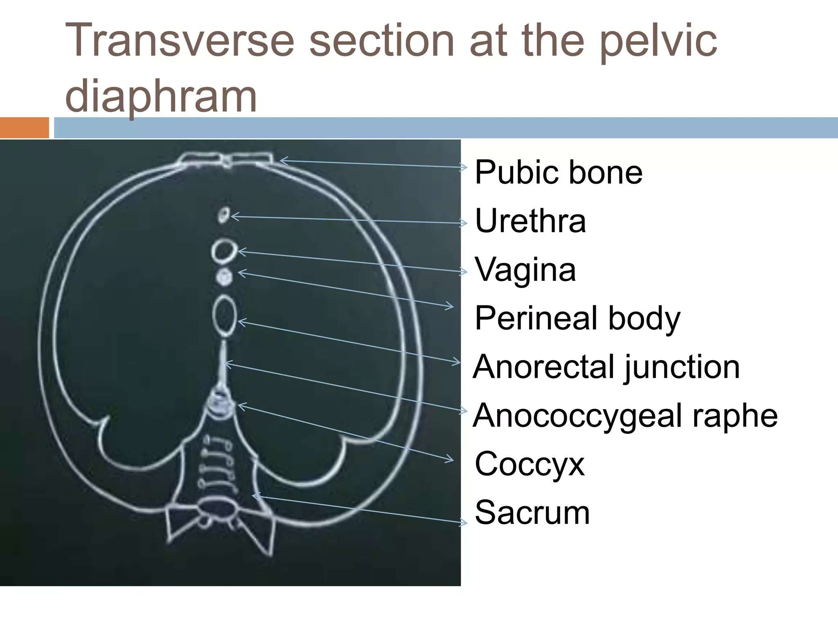

Slide 9
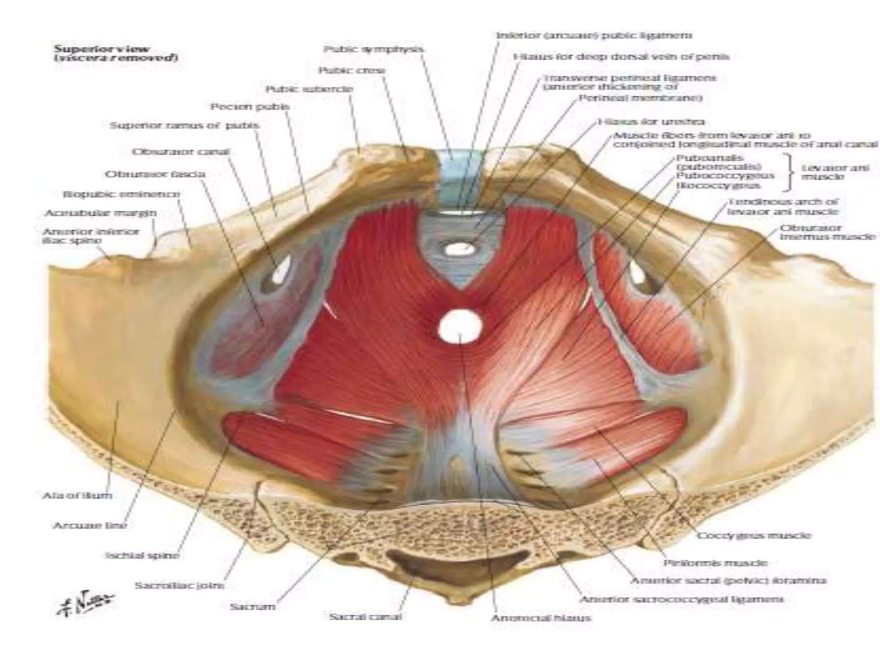

Slide 10
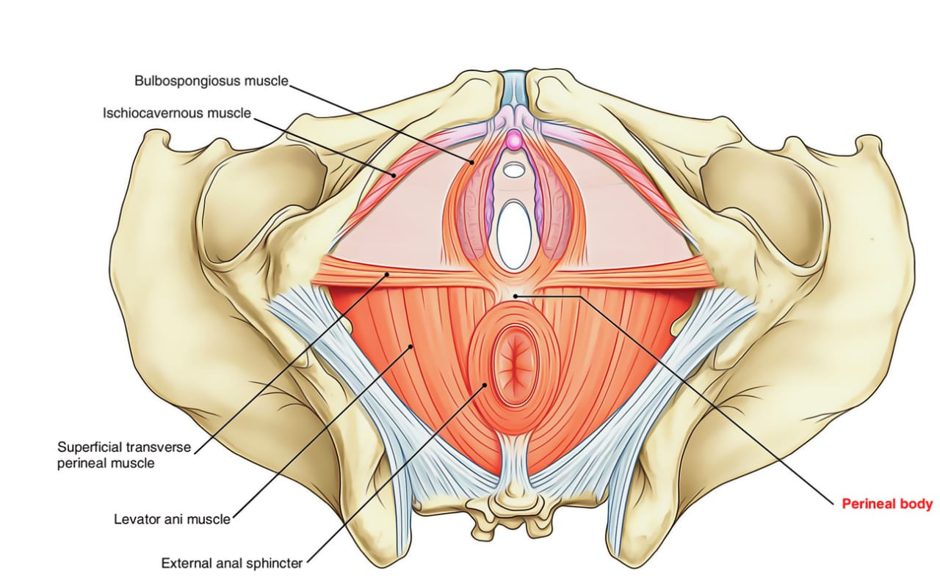
Pelvic floor- inferior view

Slide 11
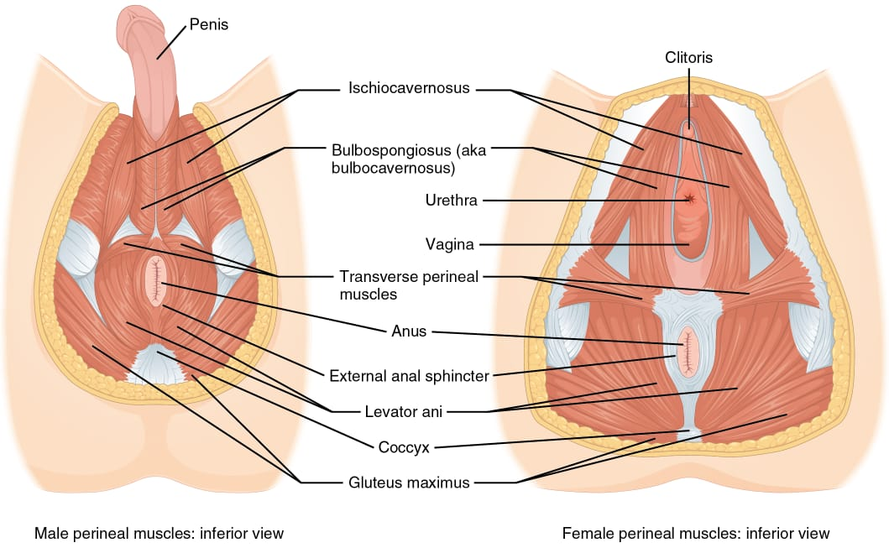
Pelvic floor- inferior view

Slide 12
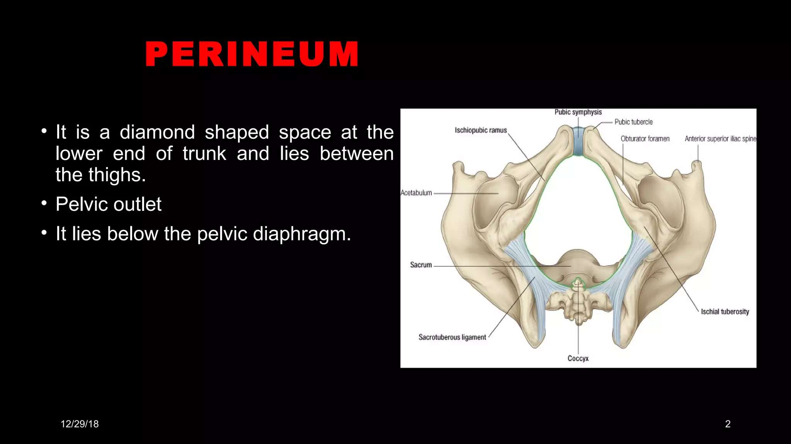

Slide 13
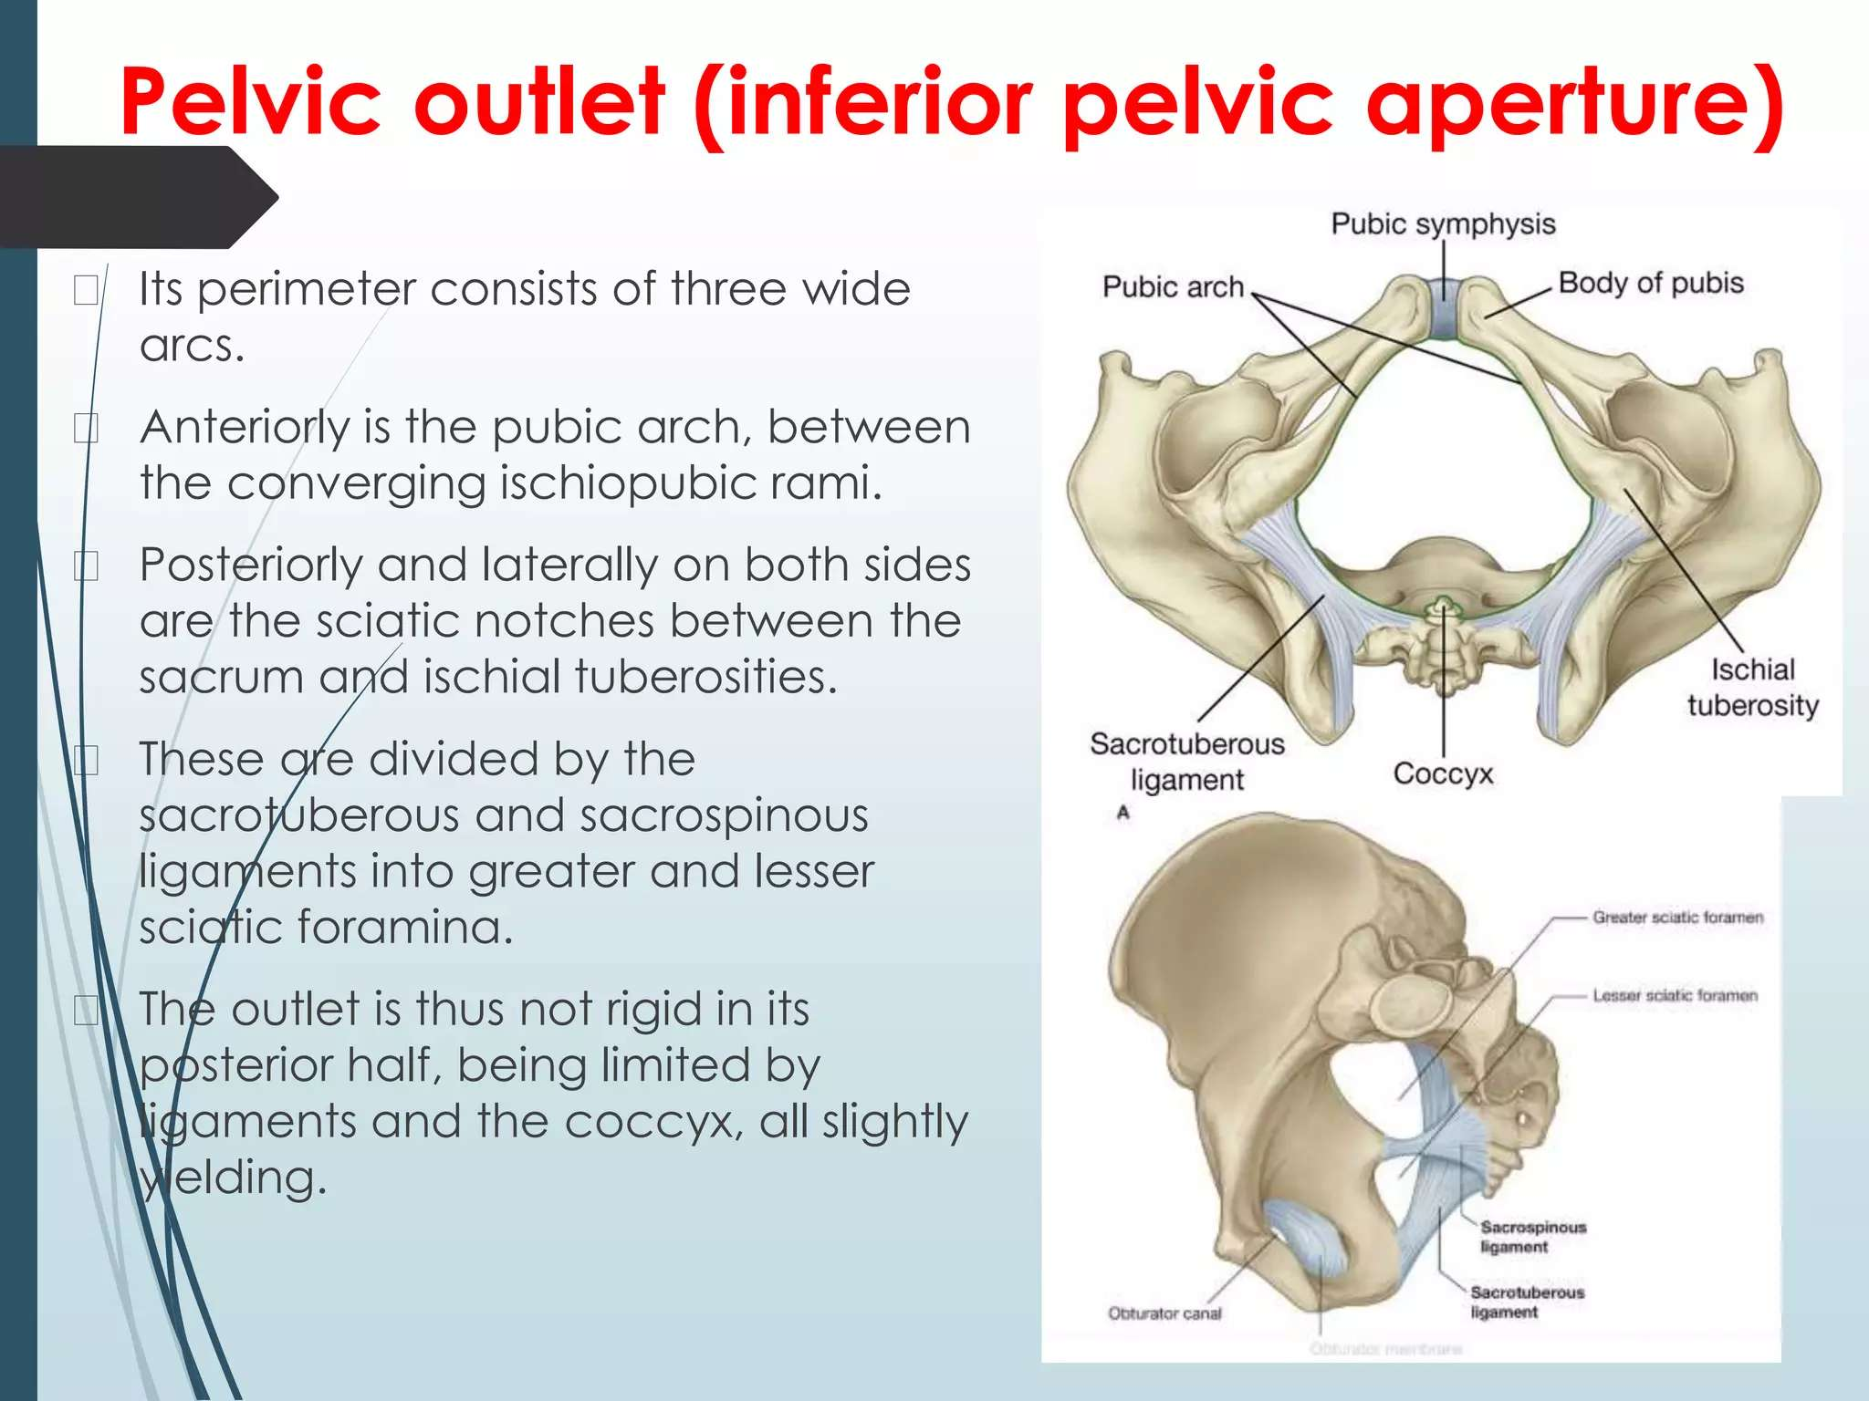

Slide 14
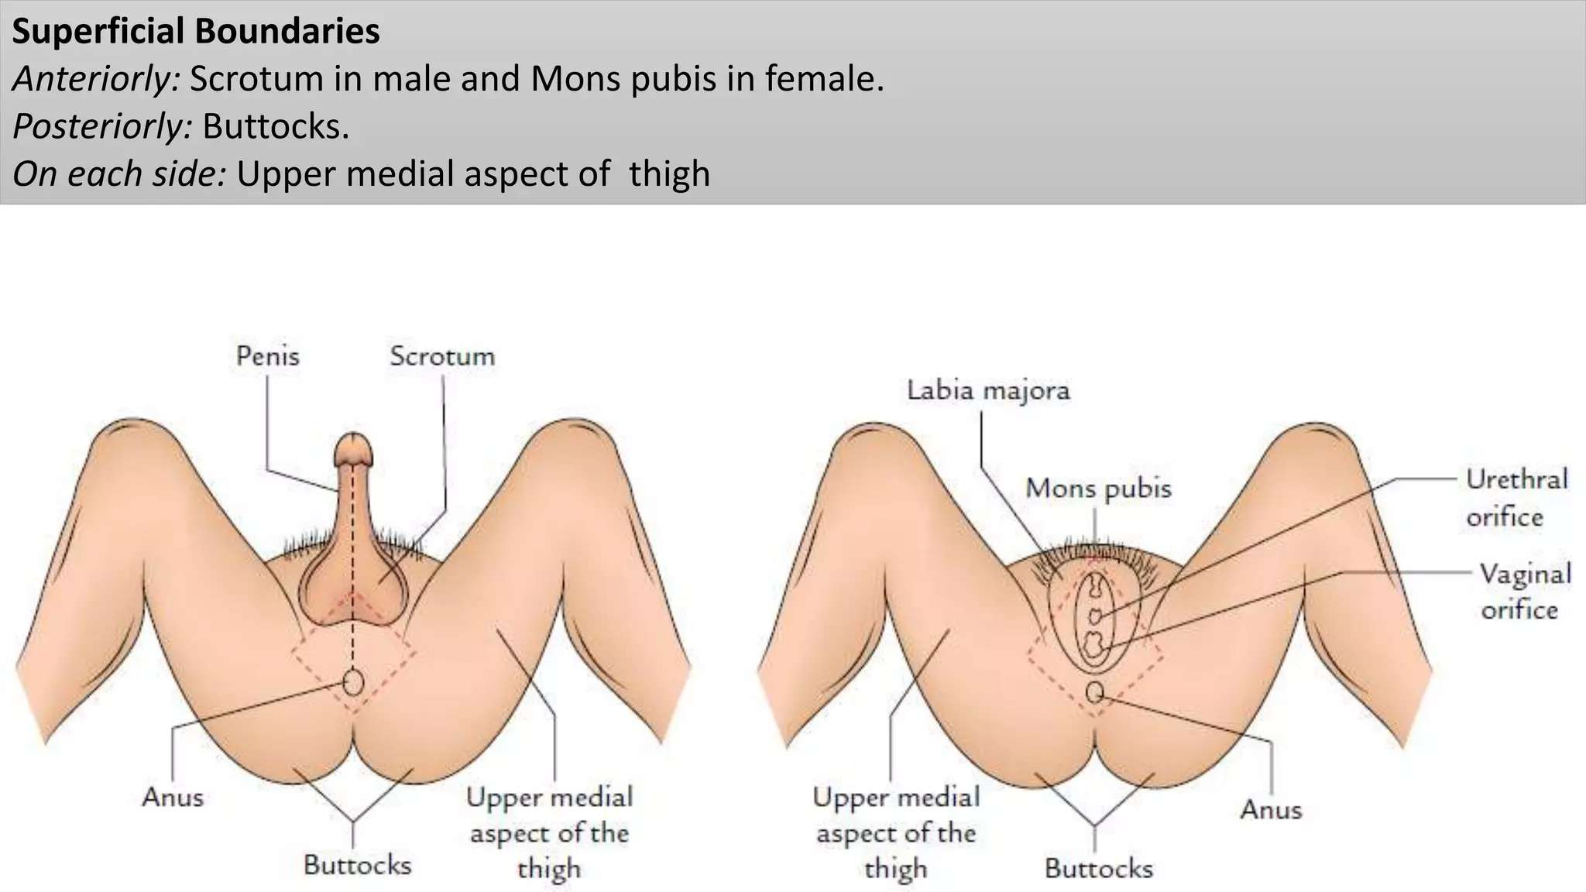

Slide 15
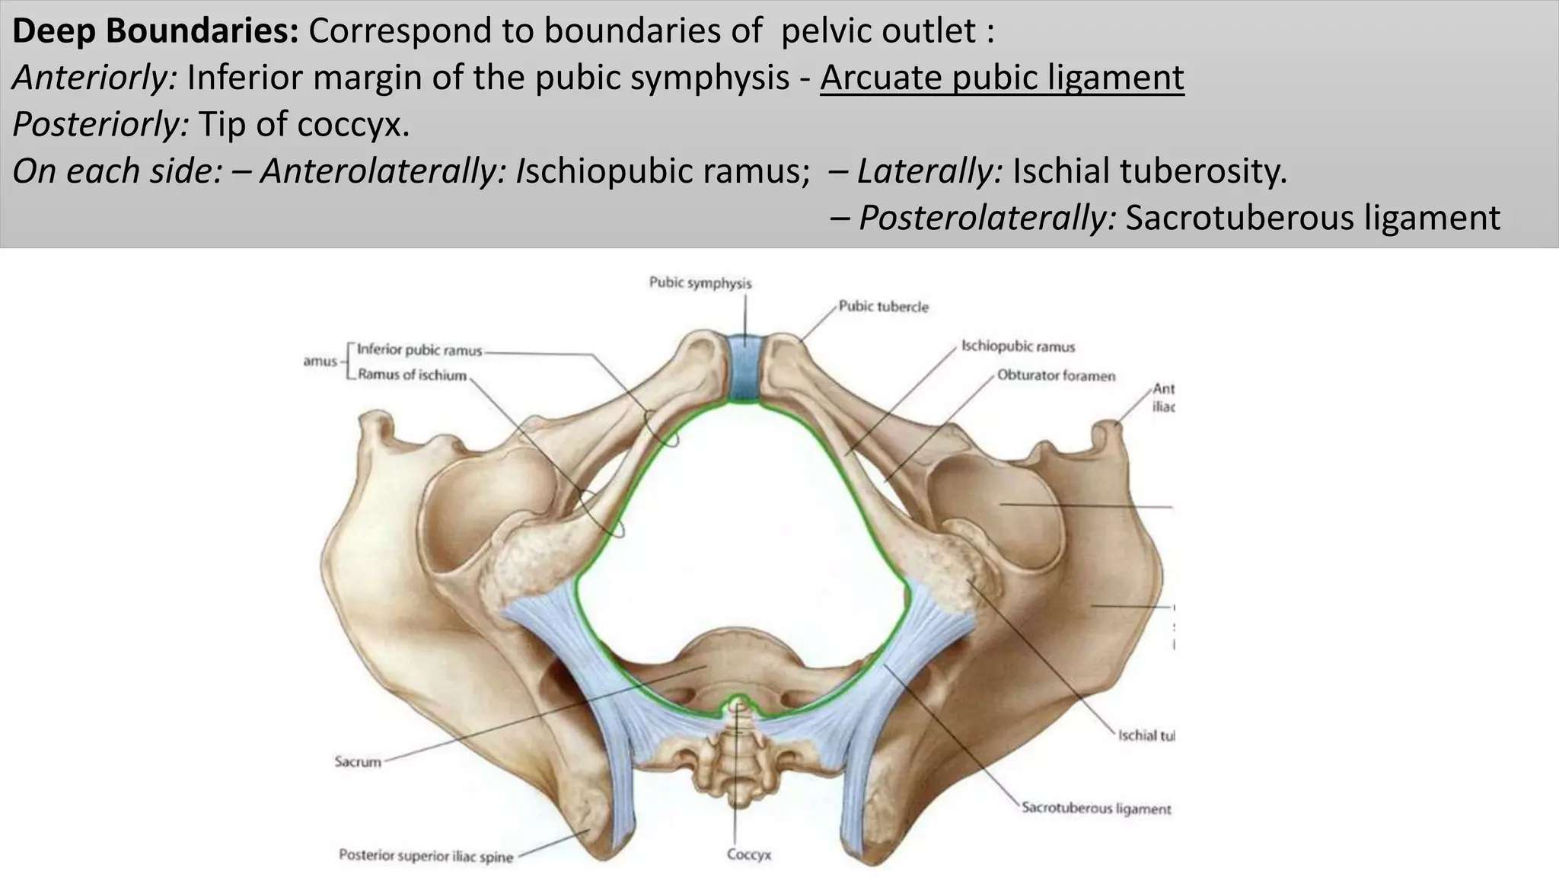

Slide 16
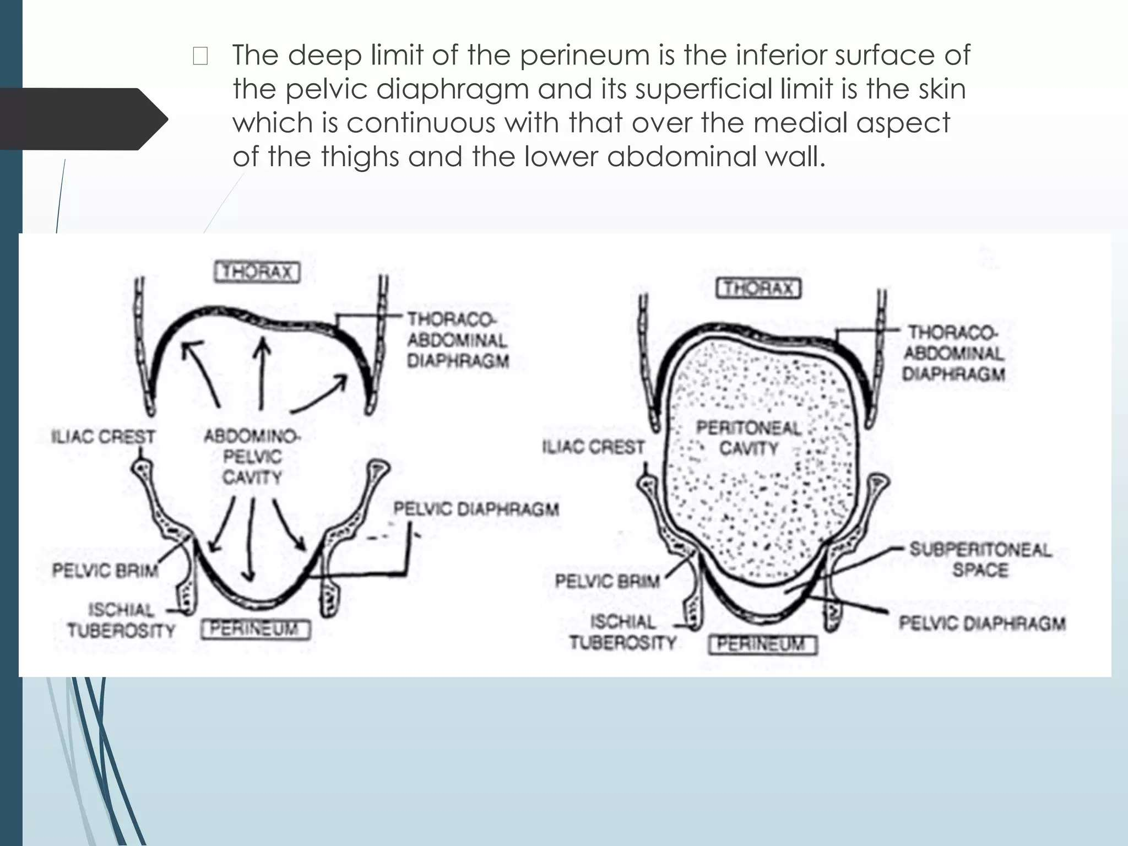

Slide 17
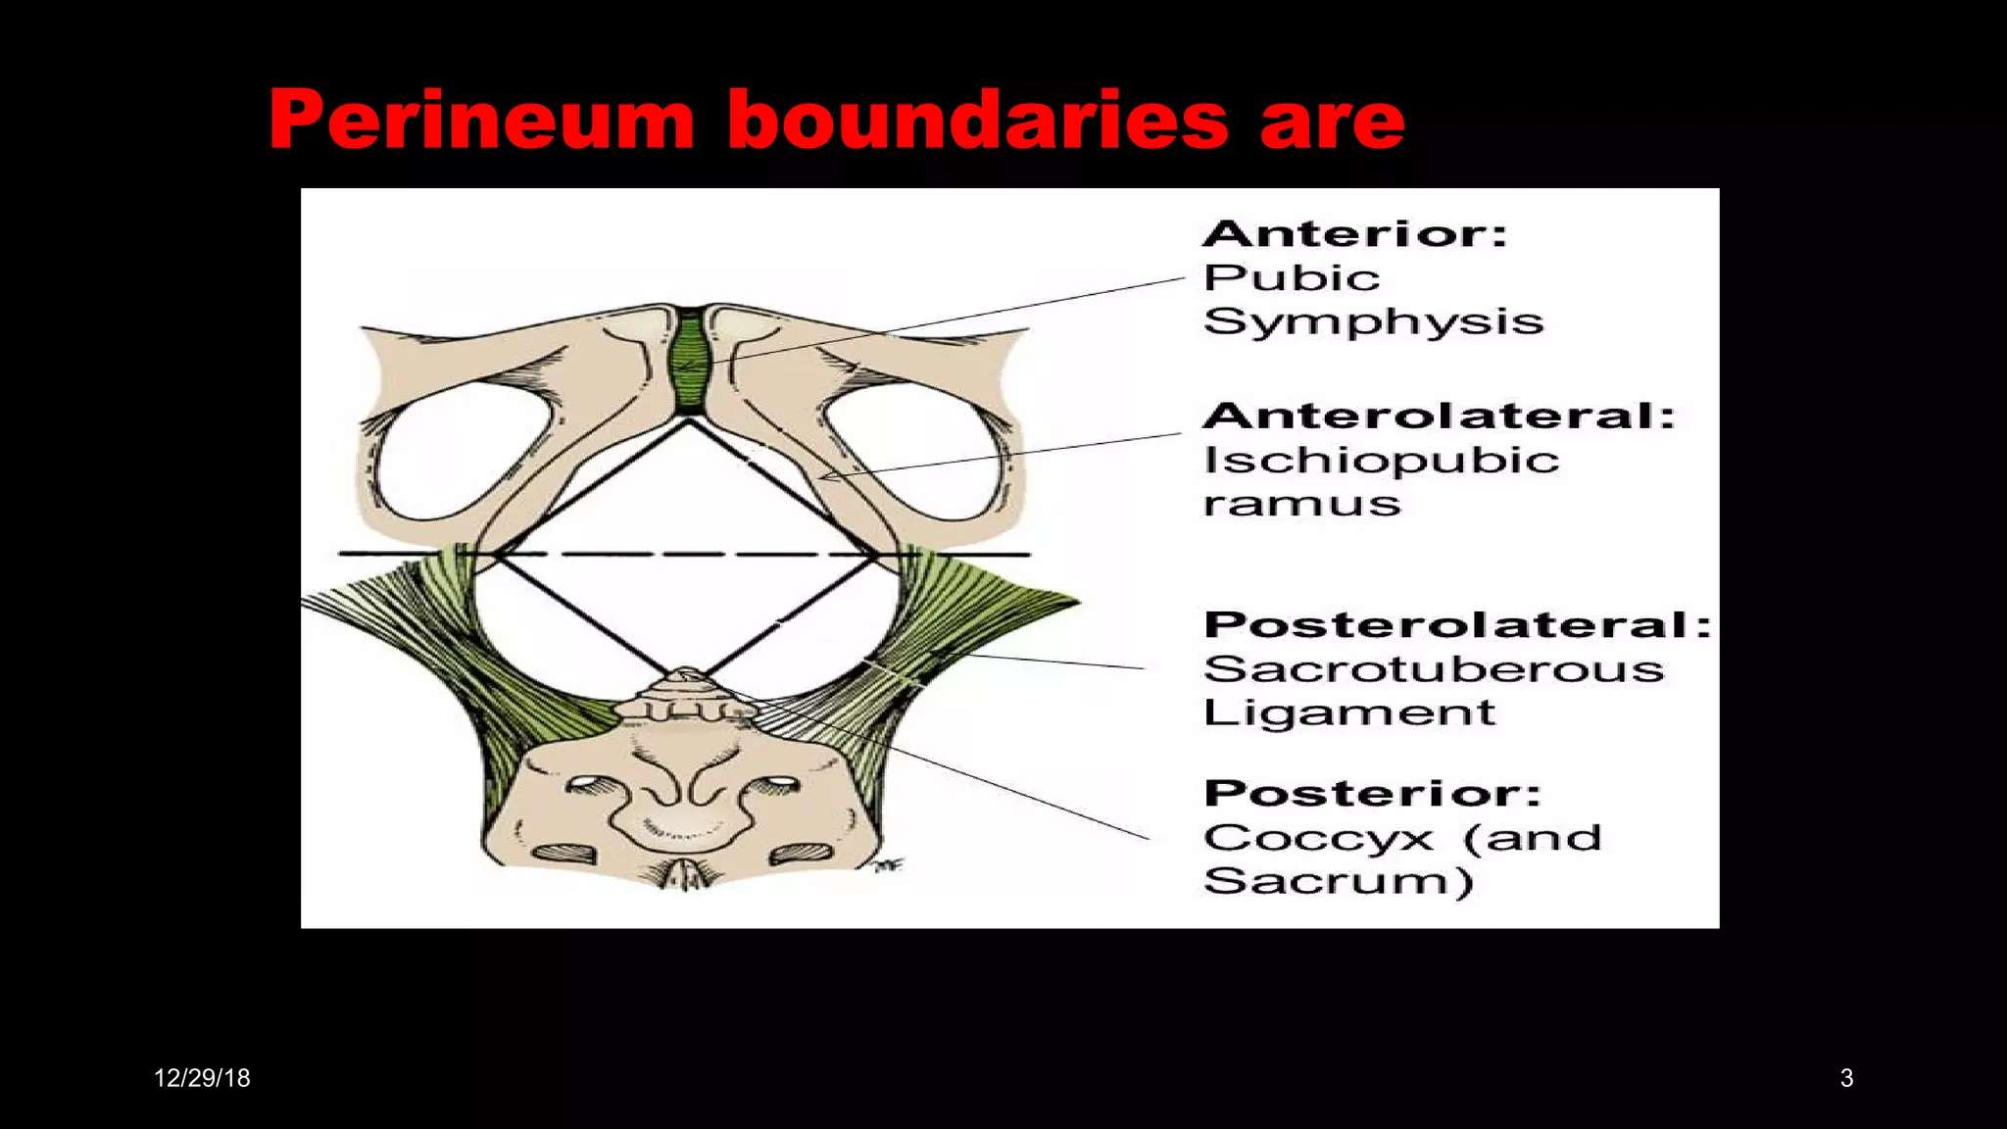

Slide 18
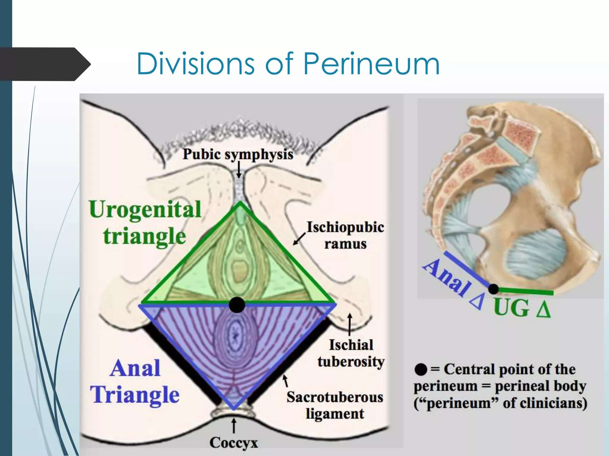

Slide 19
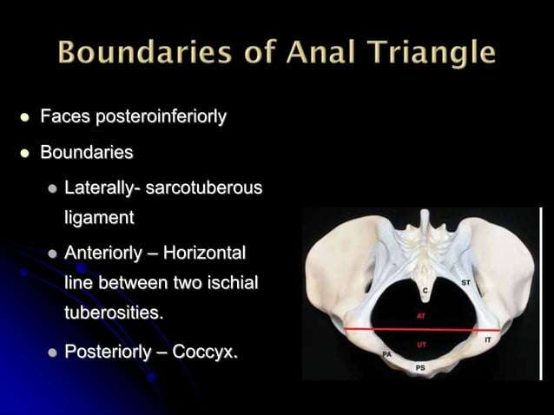

Slide 20
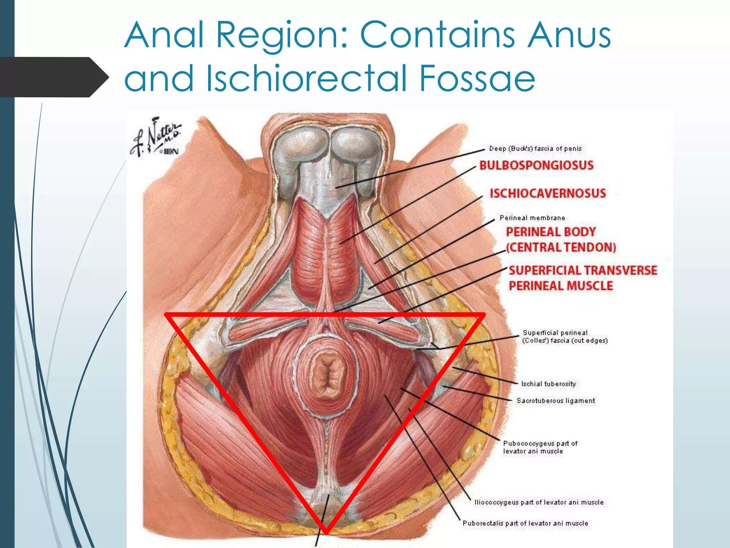

Slide 21
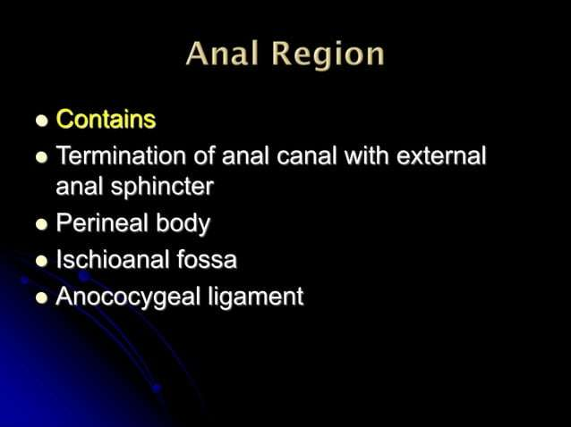

Slide 22
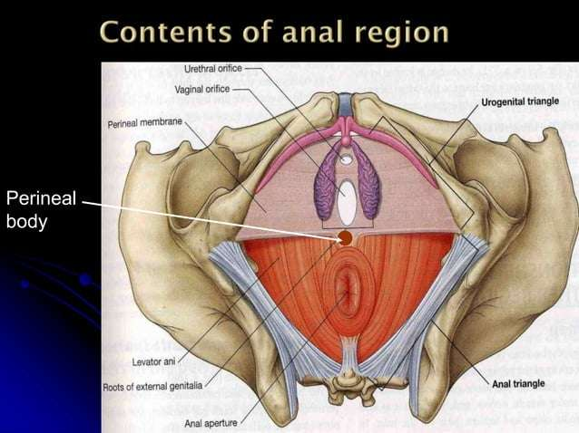

Slide 23
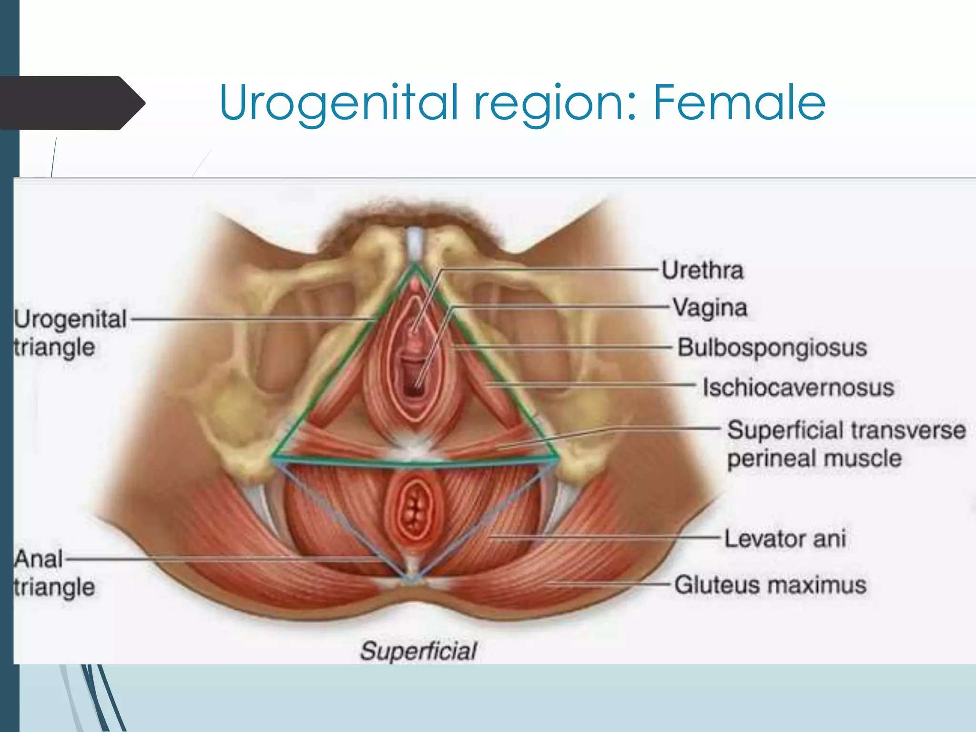

Slide 24
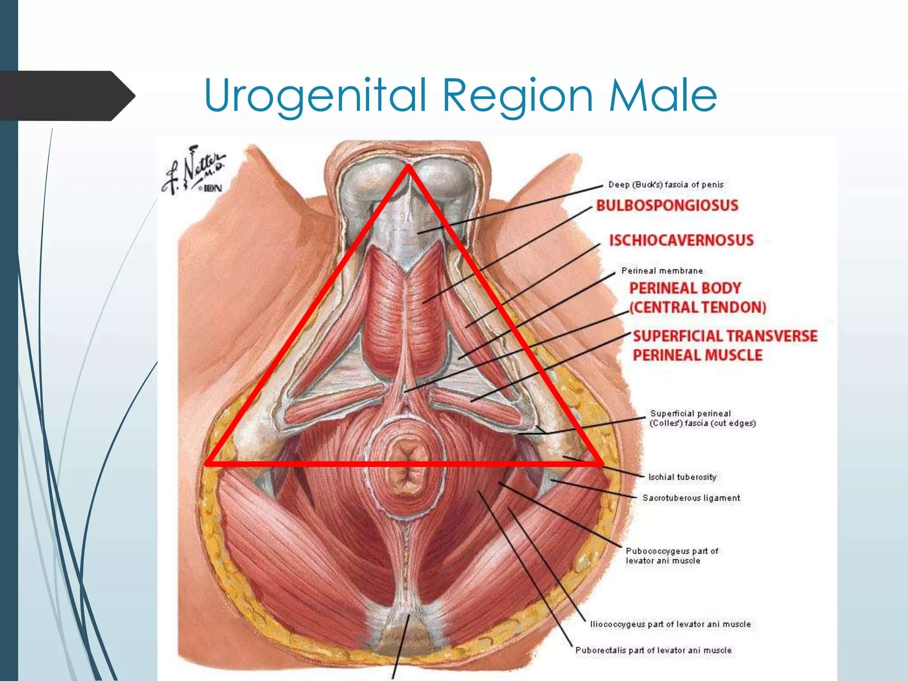

Slide 25
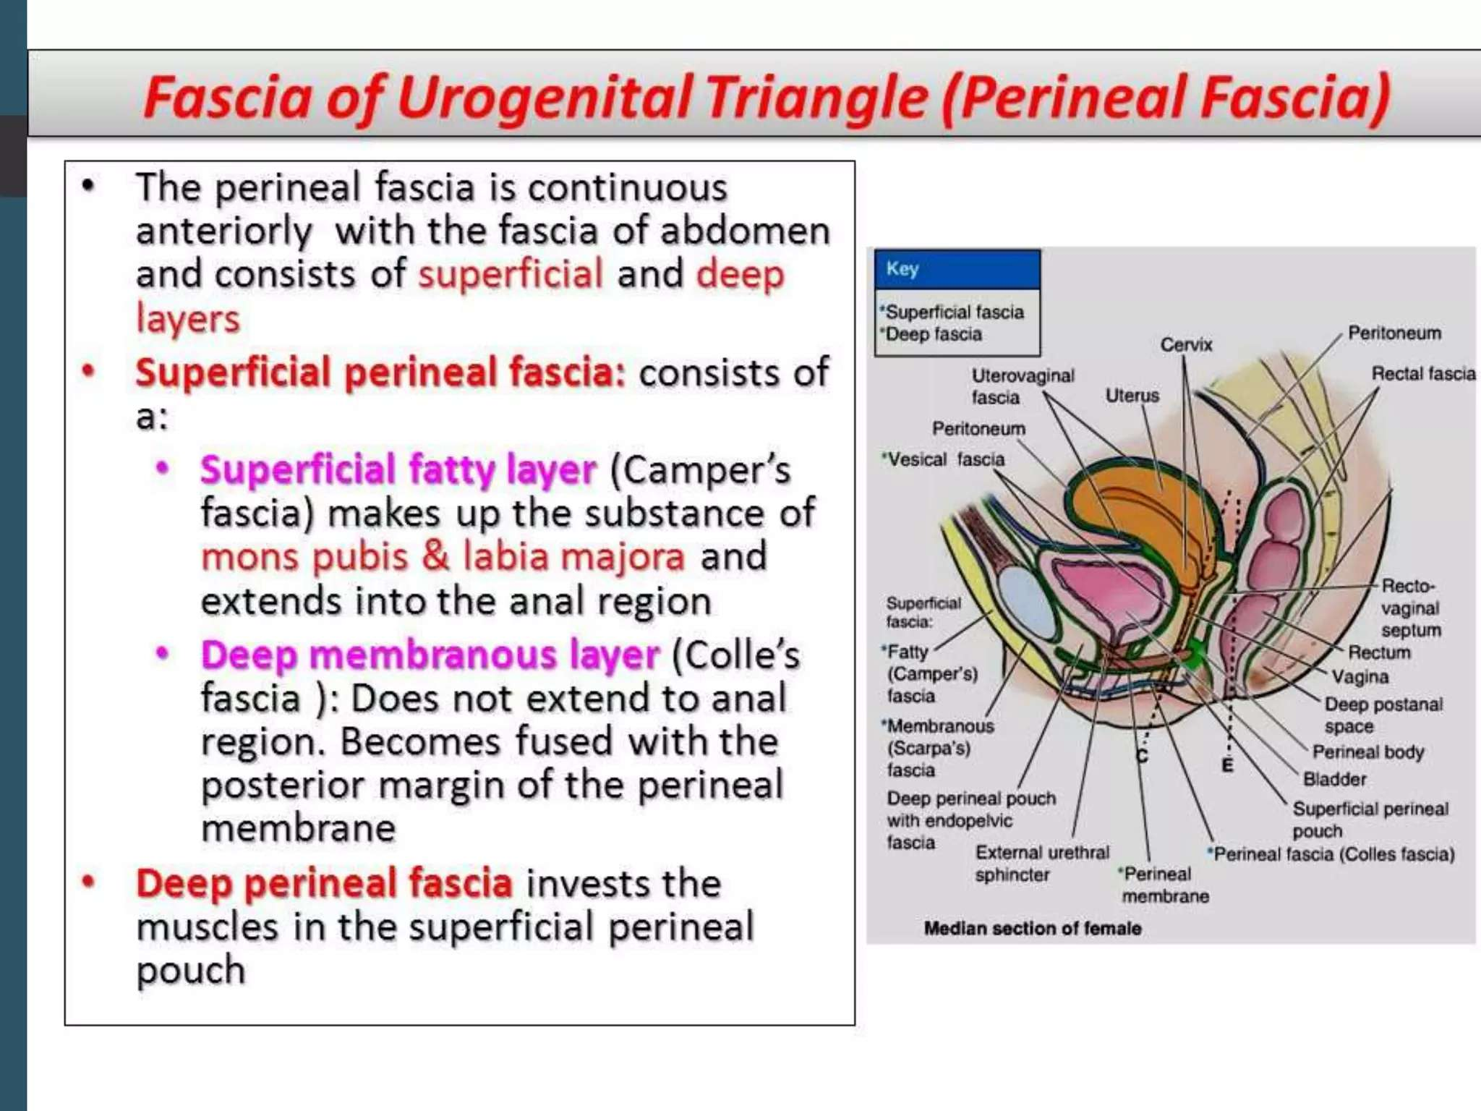

Slide 26
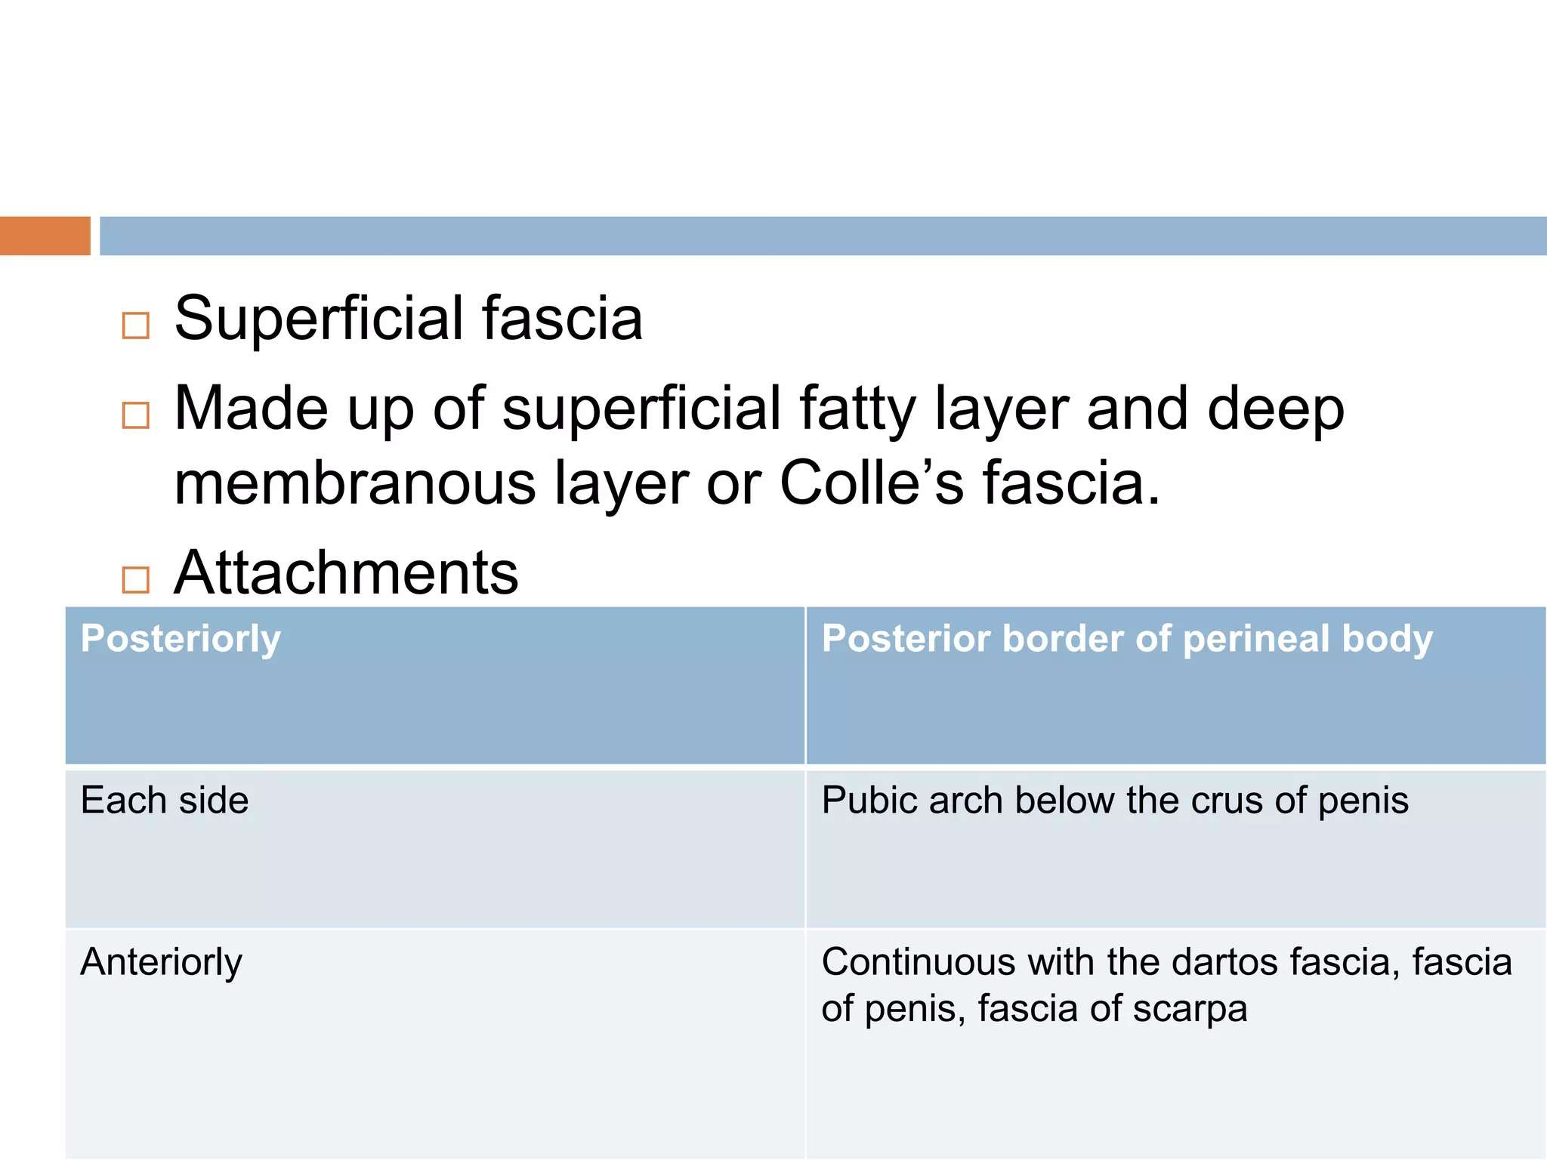

Slide 27
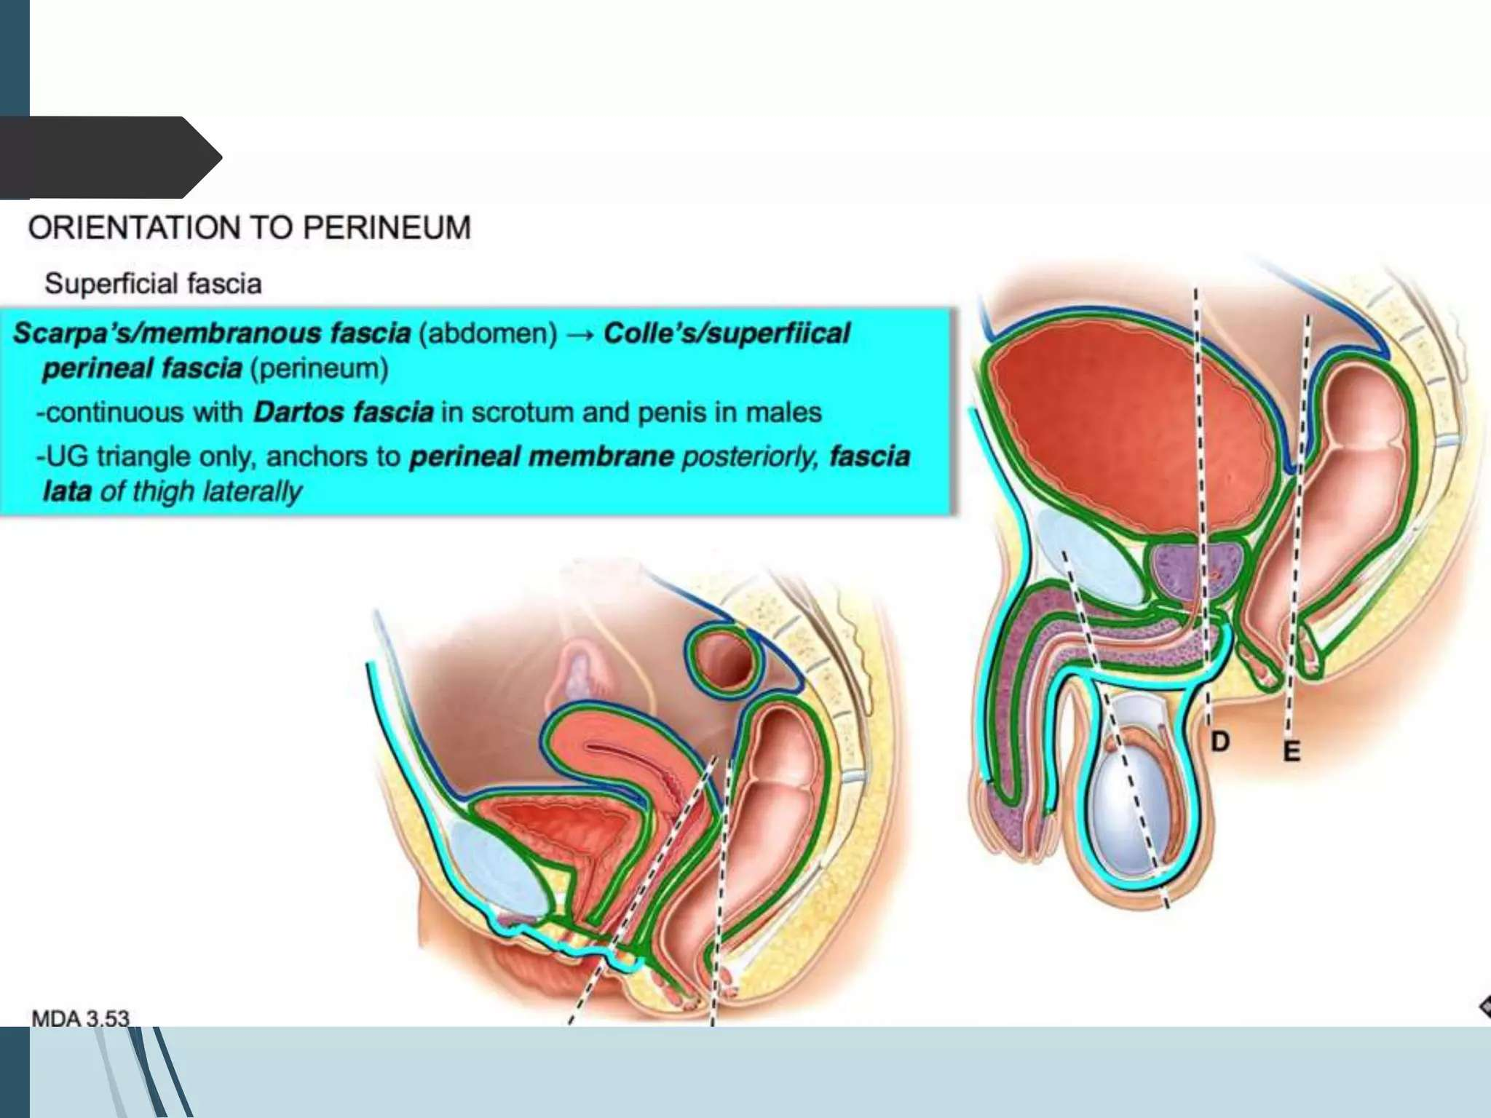

Slide 28
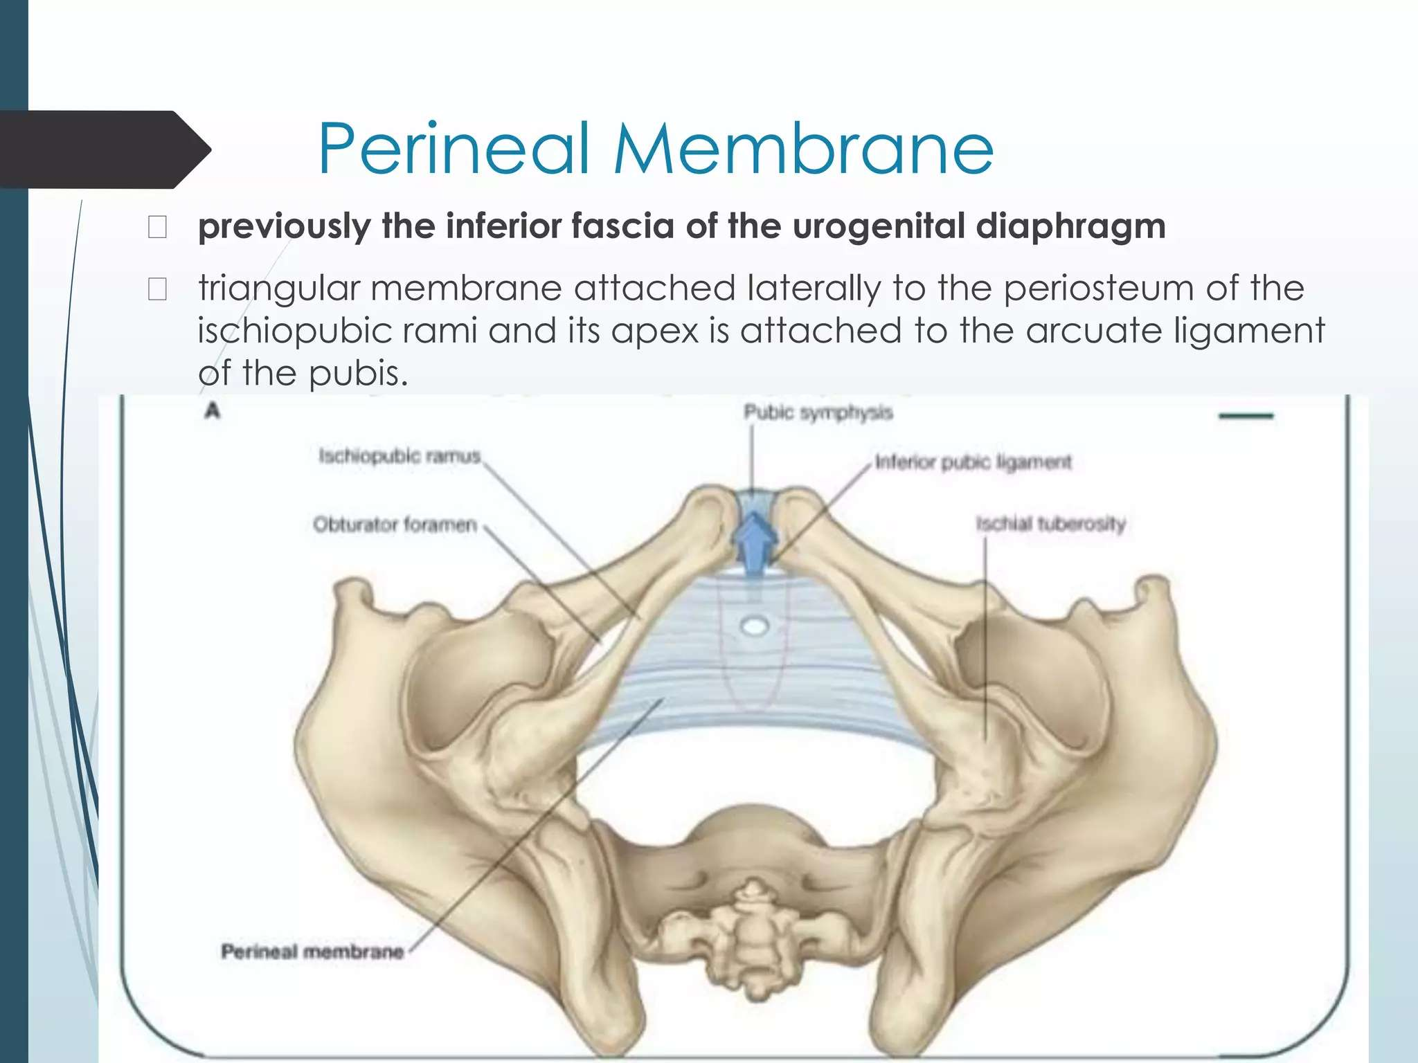

Slide 29
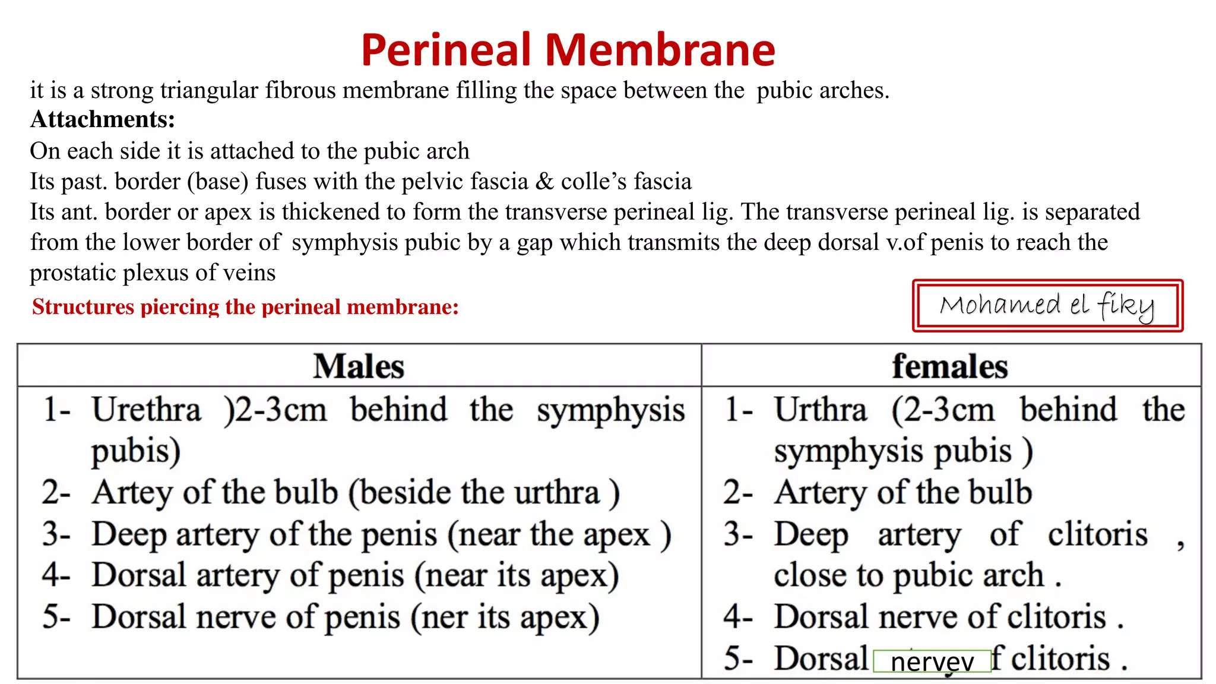

Slide 30
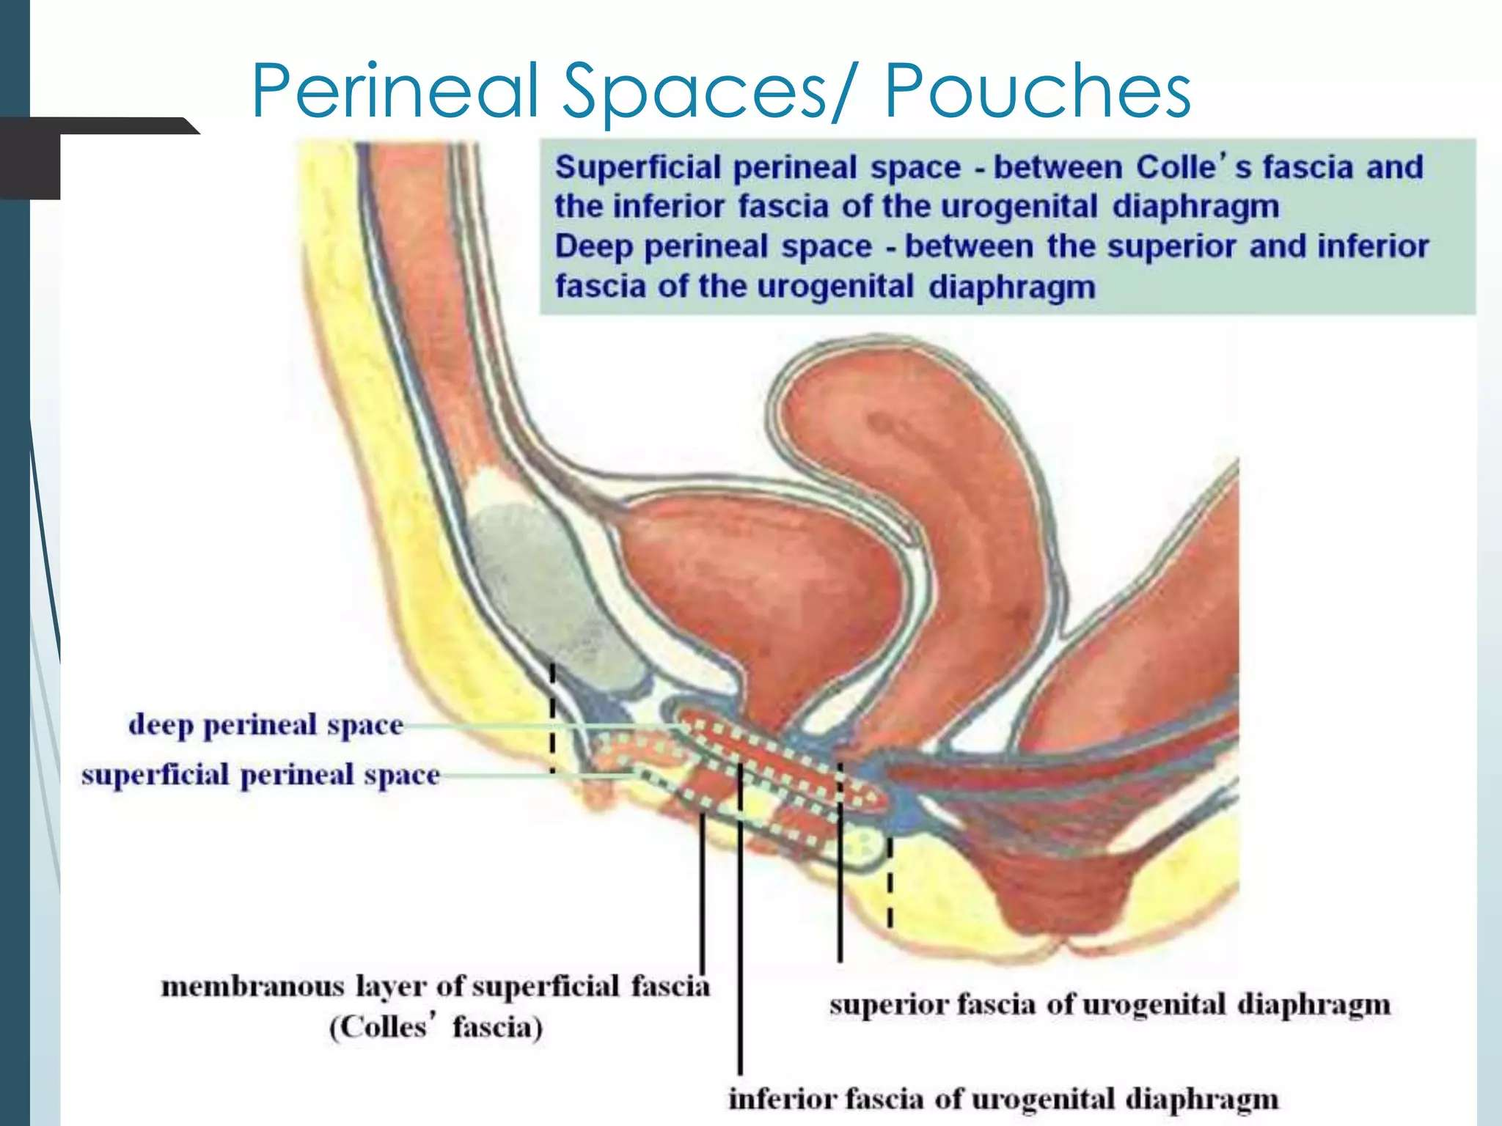

Slide 31
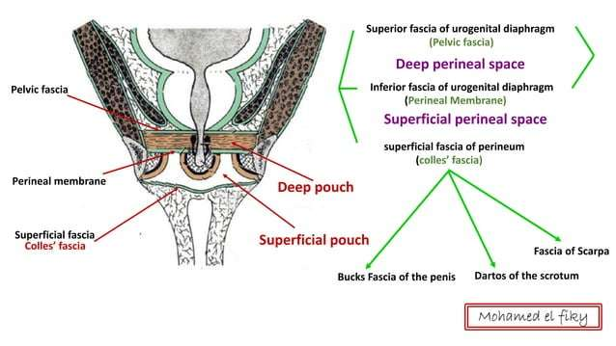

Slide 32
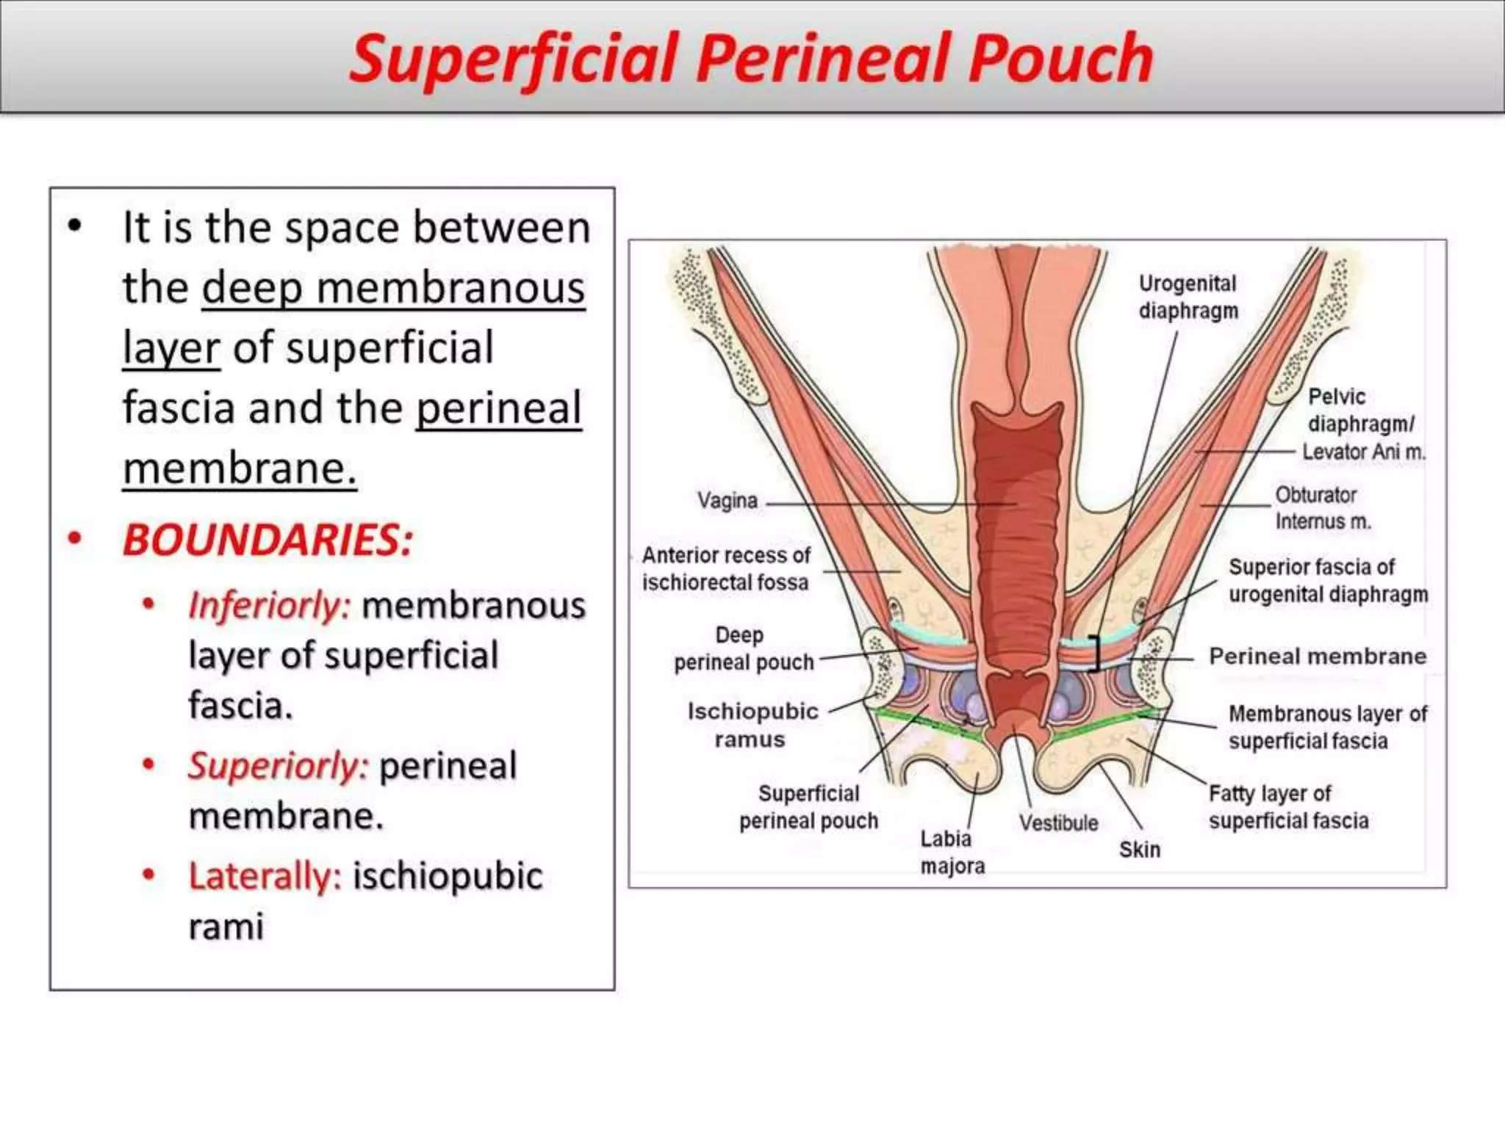

Slide 33
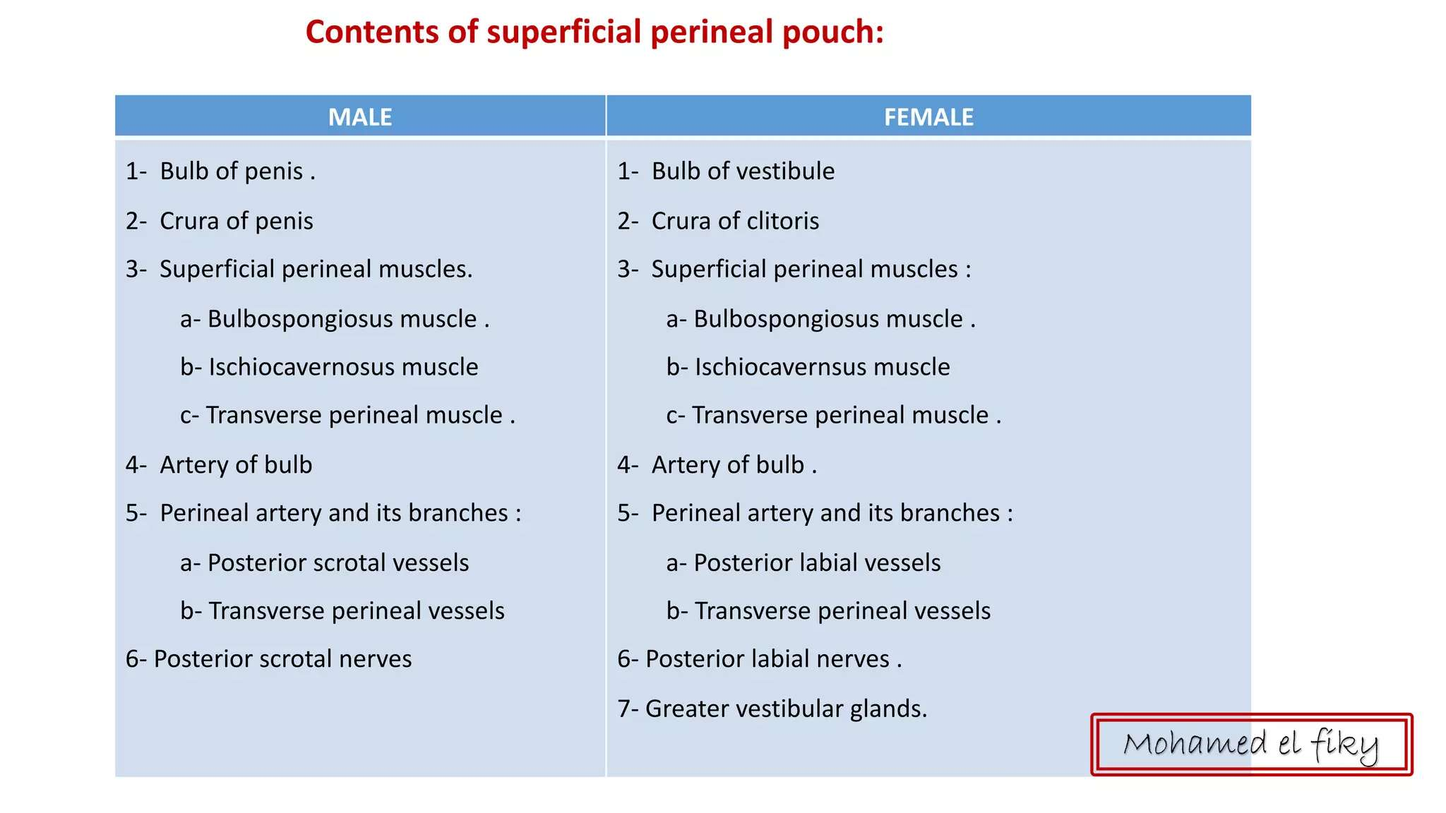

Slide 34
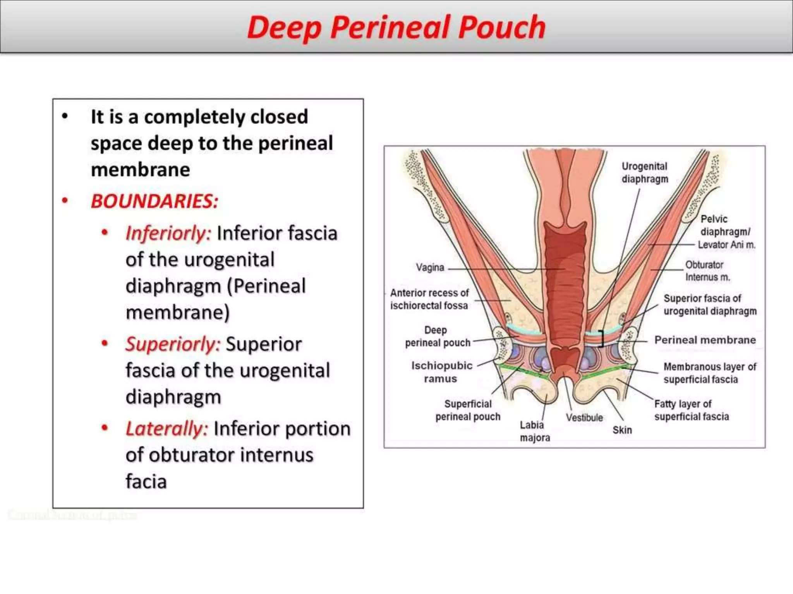

Slide 35
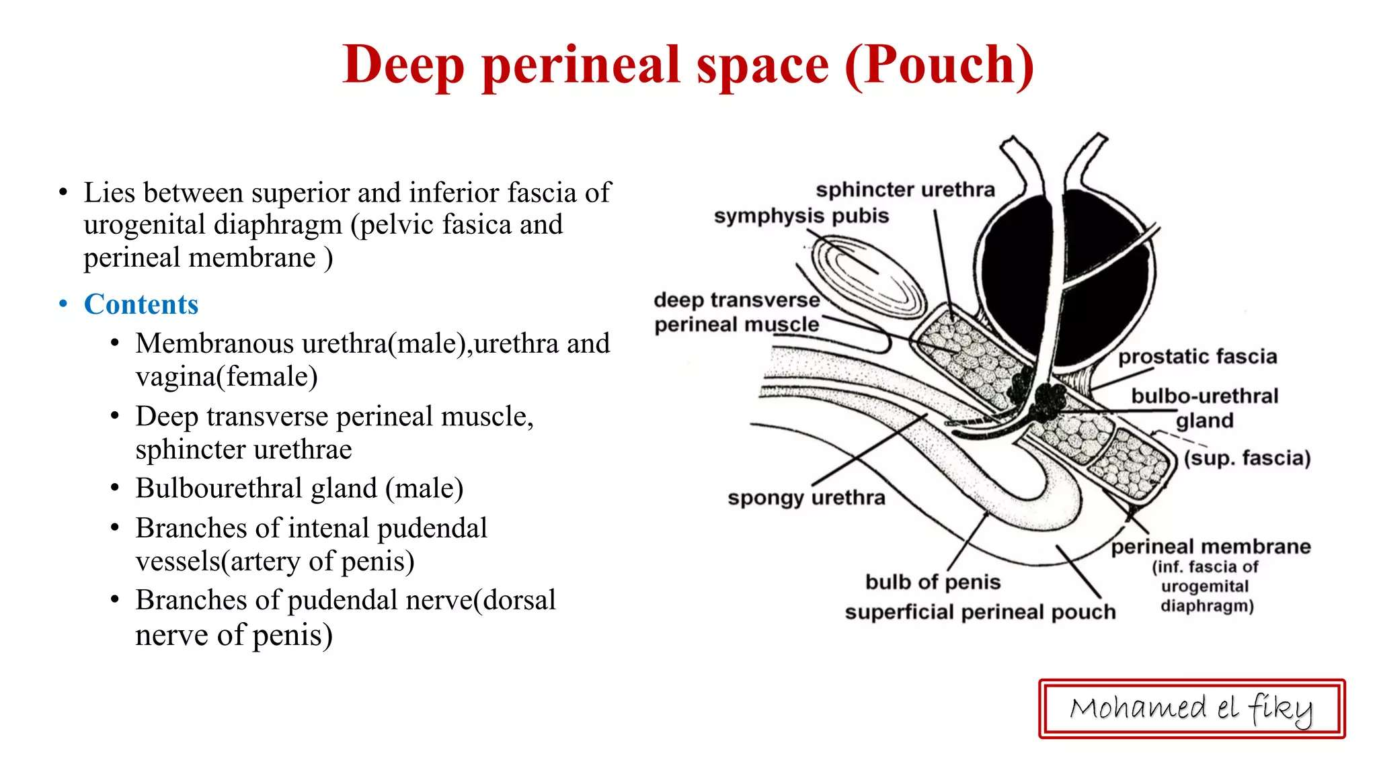

Slide 36
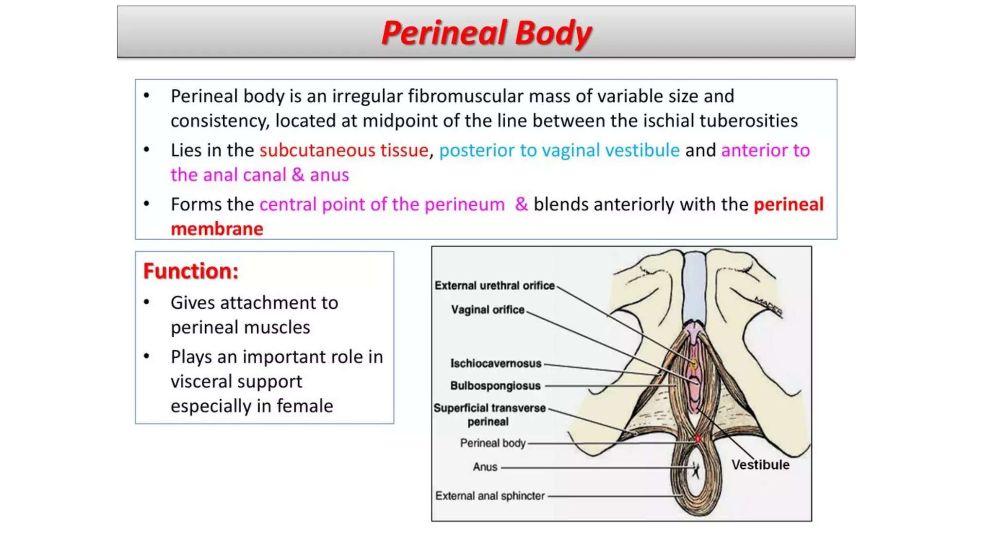

Slide 37
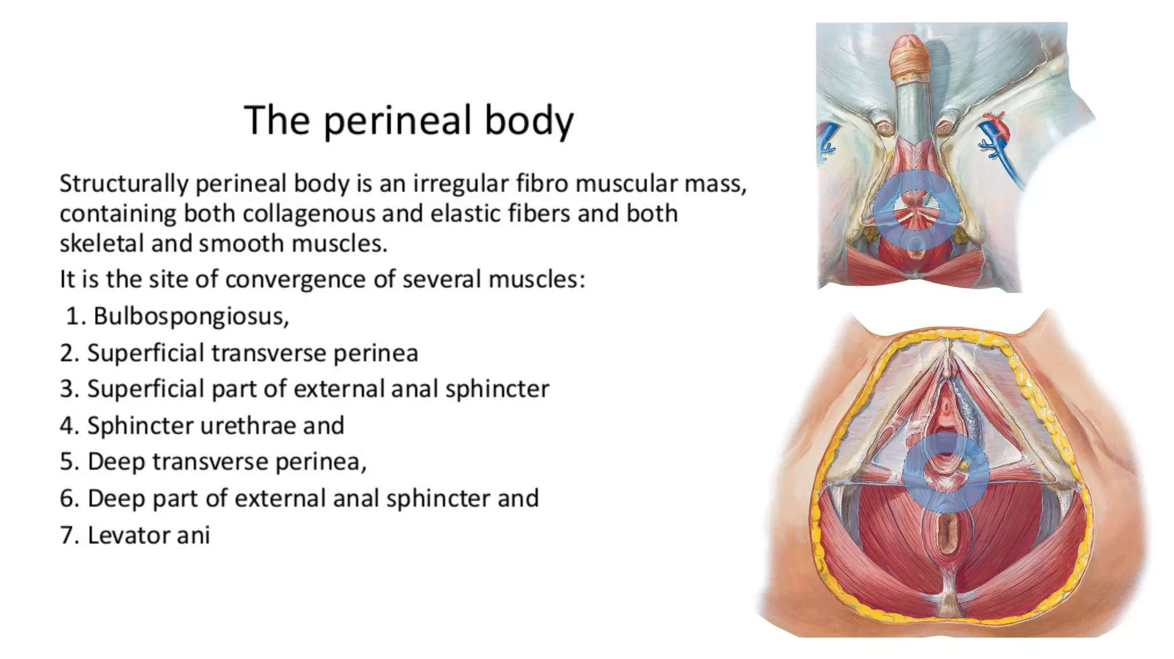

Slide 38
Neurovascular supply
Pudendal nerve (S2-S4)
Internal pudendal artery

Slide 39
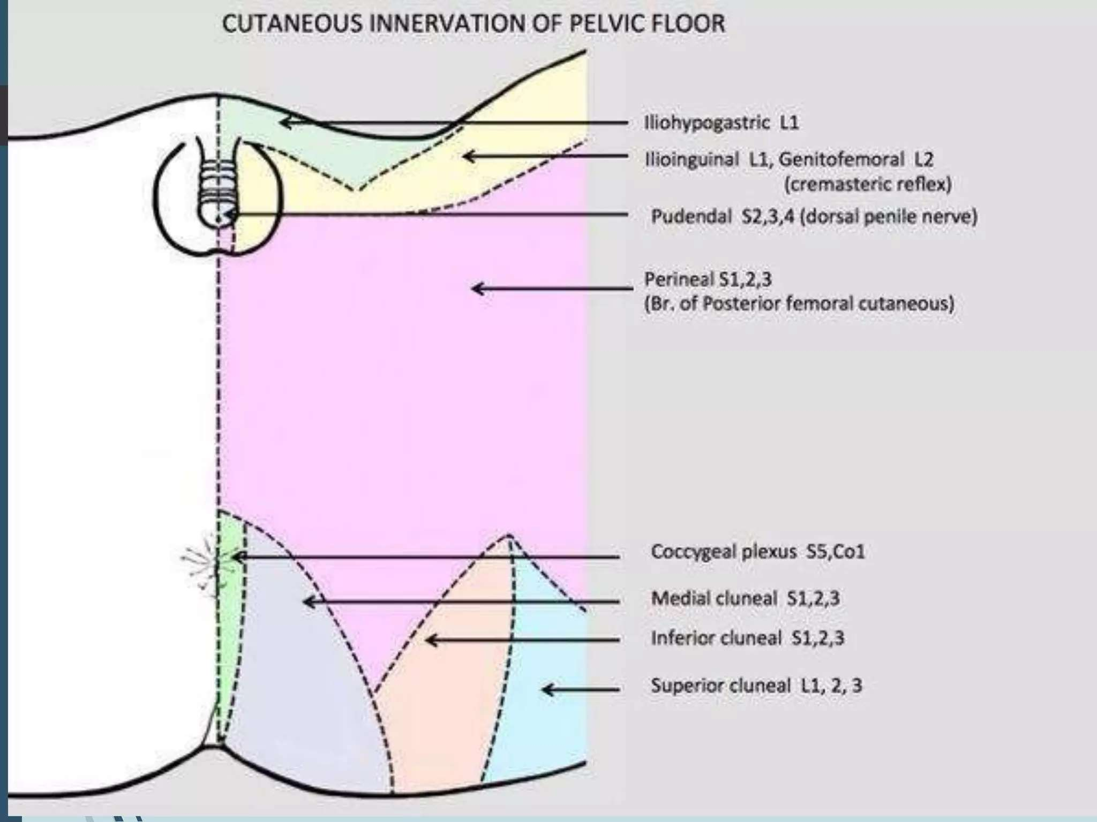

Slide 40
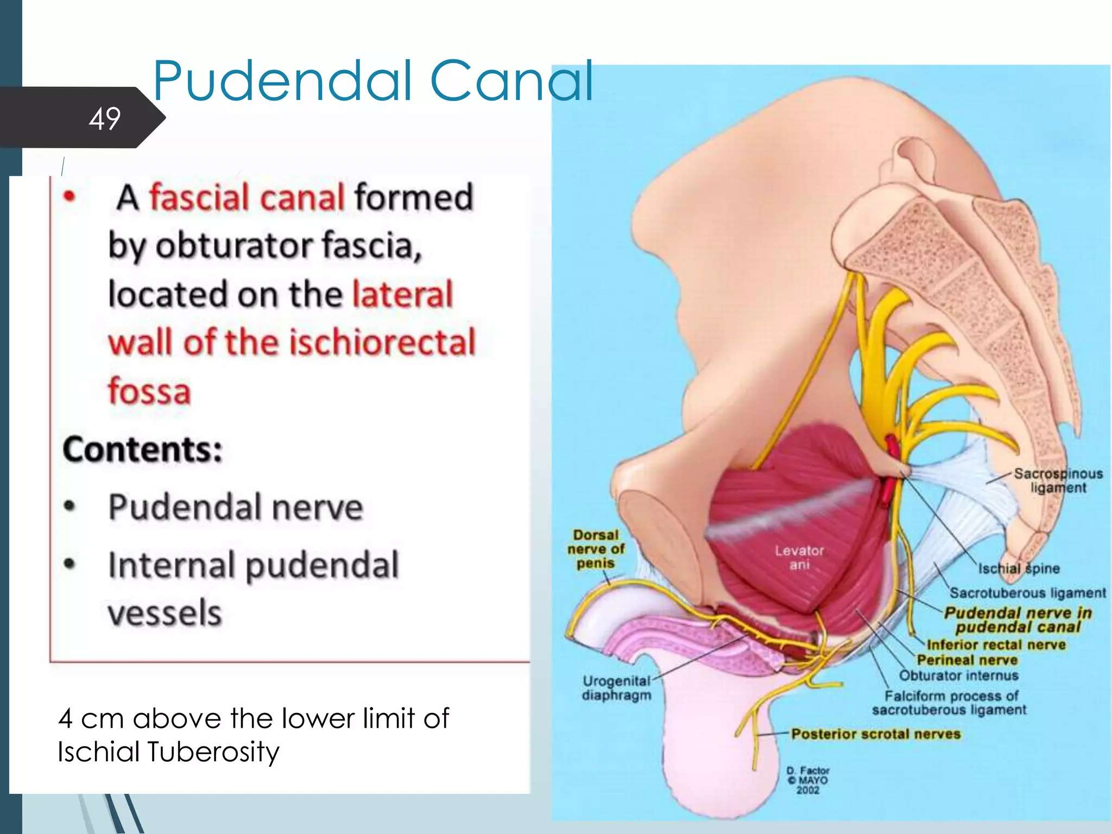

Slide 41
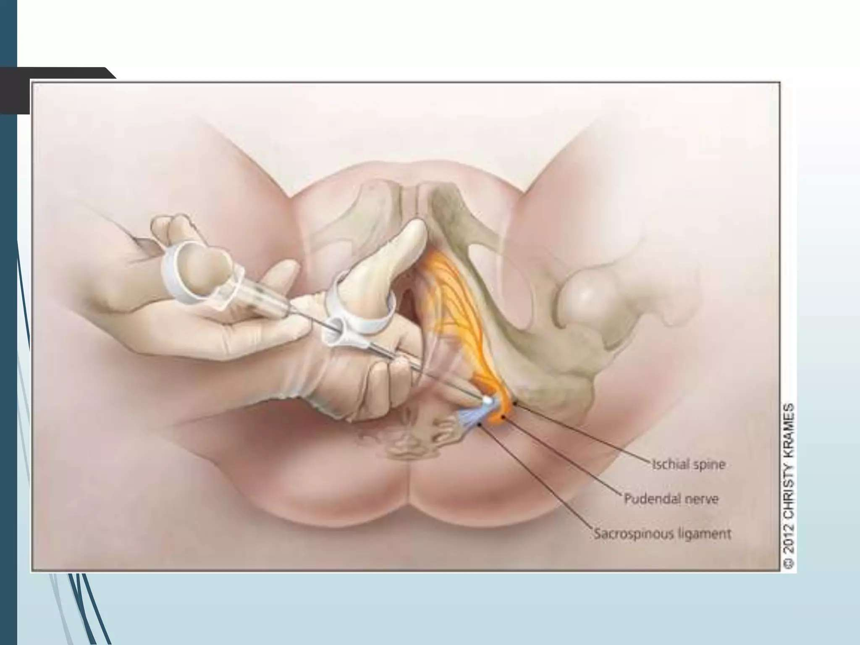

Slide 42
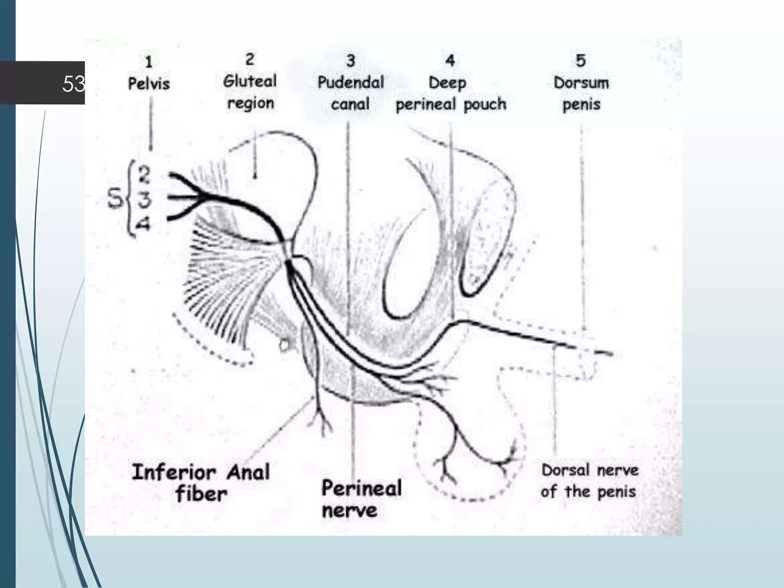

Slide 43
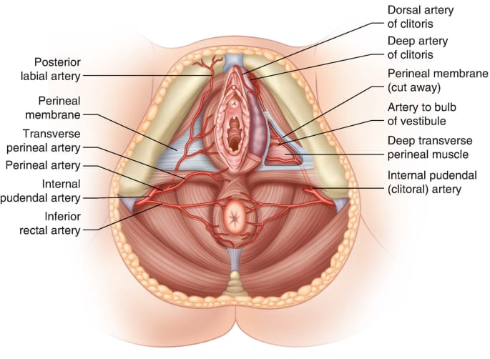

Slide 44
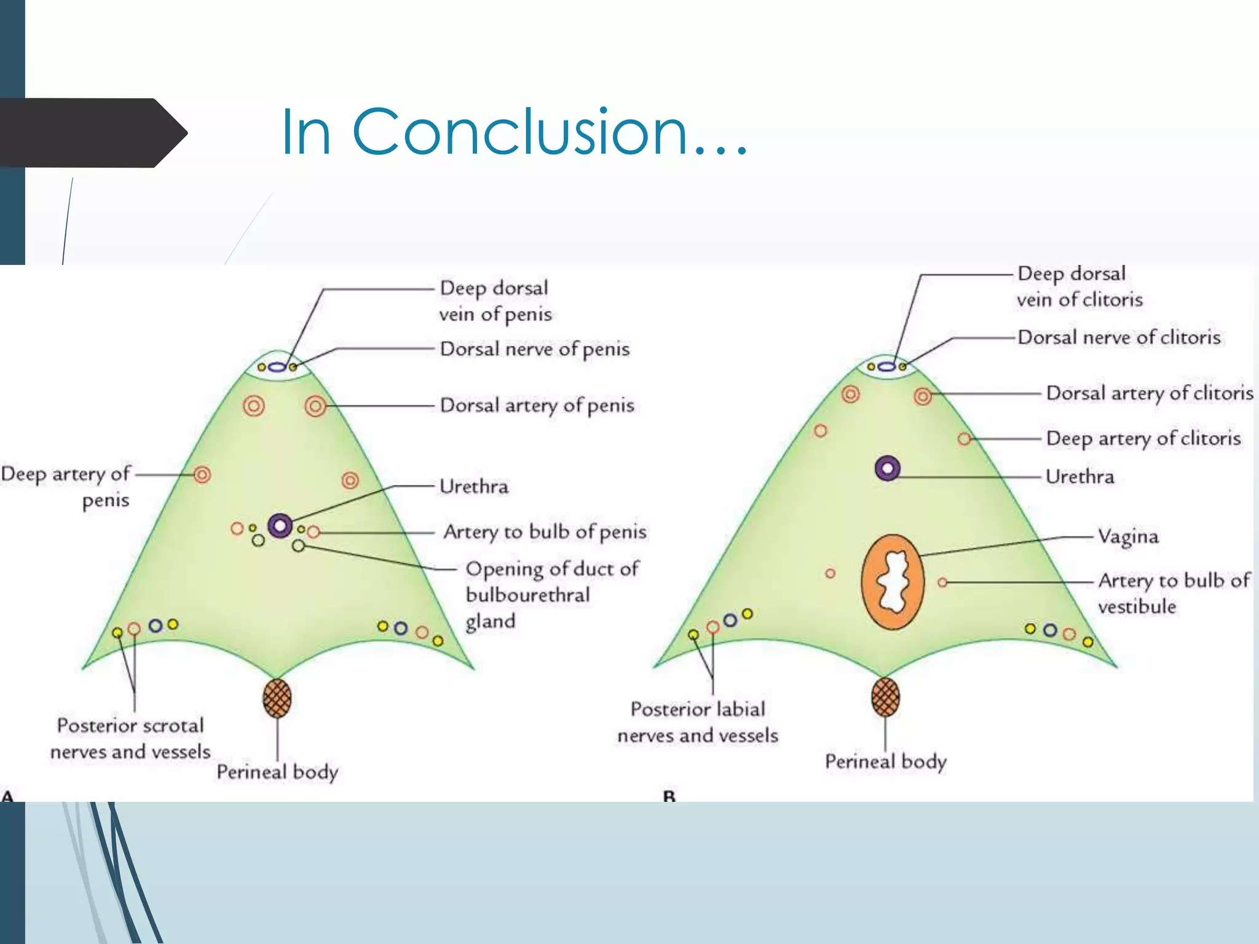

Slide 45
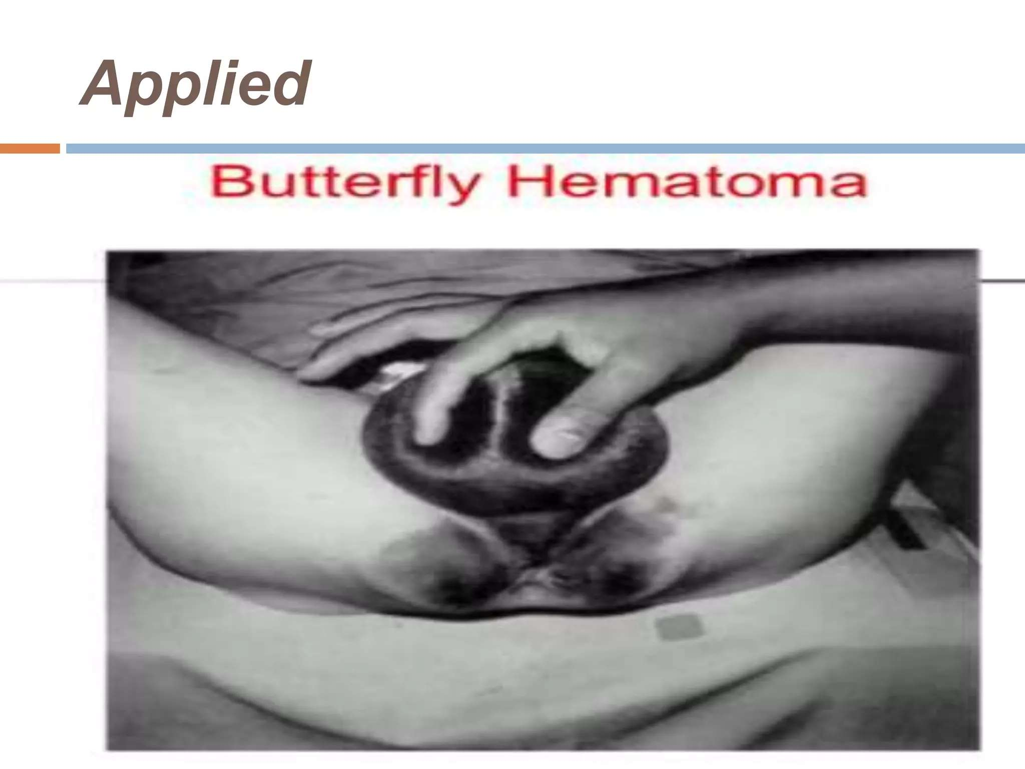

Slide 46
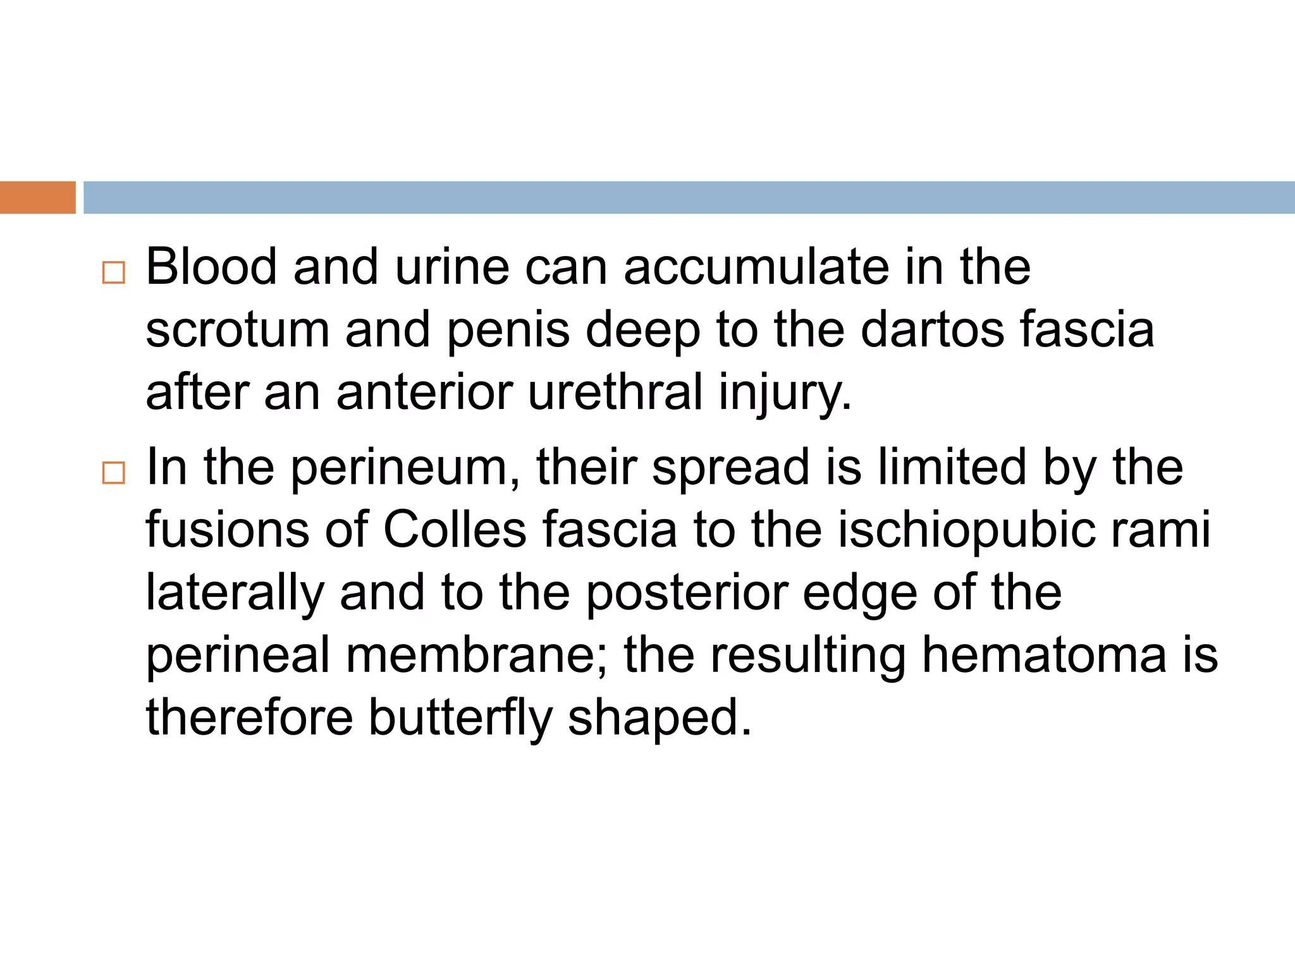

Slide 47
THANKS

